Slide 1
State of Circle & Executive Board Vote January 9, 2023
Notes:
Donna

Slide 2
2020-2022 Executive Board
Donna Kreis, Chair
Bonnie Miranda, Vice-Chair & Secretary
Kim Malat, Past Chair
Monica Worrell, Treasurer
Sara Burley, Grant Committee Chair
Allison Cuneo & Donna Kahoe, Membership & Outreach
Committee Co-Chairs

Slide 3
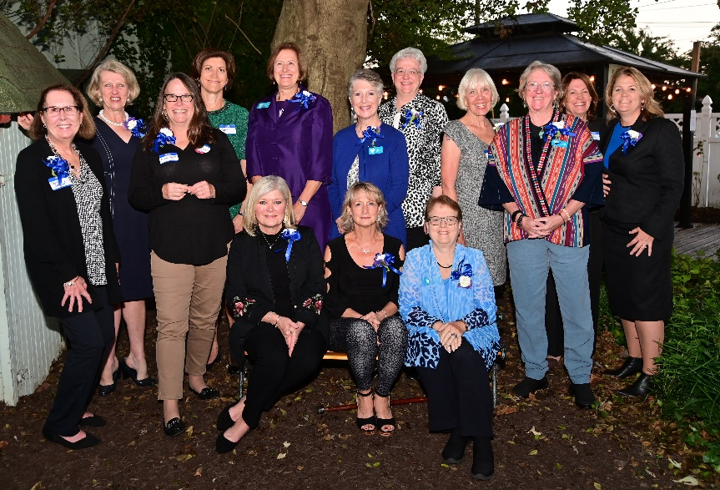
State of the Circle
45% increase in membership
equates to $18,000 of additional grant dollars
Reached $500,000 in giving
Celebrated our 10th Anniversary
Revamped the Membership and Outreach Committee

Slide 5
Circle Update – Grants to Date
12 Years
$ 510,200.14
149 Grants
58 Nonprofits serving women, families, and children in Harford County

Slide 6
Finance Update
Monica Worrell

Slide 7
Fund Balances
$133,630.27 – Endowed Fund (as of 12/31/2022)
(held by Community Foundation of Harford County)
$56,852.21 – Grant Fund for 2023 (as of 1/8/2023)*
(held by Grapevine Giving Foundation)
$ 866.52 - Administrative Fund (as of 1/3/2023)*
(held by Faith Based Nonprofit Resource Center)
* Unofficial Balance
Balances Subject to Reconciliation

Slide 8
Grant Committee Report
Sara Burley

Slide 9
2022 Grant Year
25 applications reviewed by 16 Committee members and a total of $113,988 in requests
5 applicants applied who have never been previously awarded a grant
14 recipients awarded a total of $54.460.50
Thanks to your philanthropy, we estimate serving:
675 children
238 women/elderly
25 families

Slide 10
2023 Grant Year Timeline
January 13 – Guidelines and application posted
January 23 – Pre-application meeting for potential applicants
February 3 – Grant Committee meeting
March 10 – Applications due
March 15 to April 19 – Individual reviews by Committee
April 21 – Committee meeting - discussion and recommendations
Late April – Recommendations to Board
May – General membership meeting vote on recommendations
June – Notification to grantees, funds disbursed, press release

Slide 11
2023 Grant Year
Want to be a part of the grant decision making process?
Want to learn more about the nonprofits serving Harford County women, children, and families?
Want to be more involved with the WGC?
The Grant Committee welcomes your participation. Please plan to join us on February 2, 2023. Email wgcharfordcogrants@gmail.com for more information.

Slide 12
Members’ Choice Award
Terri Garland

Slide 13
Members’ Choice Award
2022 Committee Members
Terri Garland
Jodi Marschhauser
Kim Malat
Tami Zavislan
Notes:
Tami

Slide 14
Members’ Choice Award
2020 – First Year for the Award
Distribution from the Endowed Fund held by the Community Foundation of Harford County.
The award amount is determined by the distribution plan for the year established by the Community Foundation.

Slide 15
Members’ Choice Award
$14,892.32
Awarded to three nonprofits – each a "new" grantee for the WGC!
Notes:
Tami

Slide 16
Members’ Choice Awards
2020 - Harford County Family Assistance Fund
$4,735.54
Nominated by Marlene Lieb
2021 – Miracle League of Harford County
$4,639.50
Nominated by Julie Chmura
2022 – Brandon Tolson Foundation
$5,517.28
Nominated by Debbie Lynch
Notes:
Tami

Slide 17
Membership and Outreach Committee Report
Allison Cuneo & Donna Kahoe

Slide 18
Membership
2020 – 79 members
2021 – 109 members
2022 – 115 members

Slide 19
Engaging our Members in 2022
Some New Events:
Member Mingle at MaGerk’s
Ice Cream Social at Broom’s Bloom
Dinner and Tour at Char Hope
Holiday Volunteering with Mason-Dixon Community Services
We loved hearing from you this year. We continue to welcome your ideas and feedback on what YOU want from your member experience!

Slide 20
Consider Your Why
At the start of a new year, we hope you will pause for a few moments and consider your why.
Why are you a member of the WGC?
Why did you join?
Why have you stayed connected?

Slide 21
The greater our membership, the greater our giving!
Do you have a friend, family member or colleague who is interested in the Women’s Giving Circle?
Share with them power of collective philanthropy!

Slide 22
Renew with a Recurring Gift
The start of the year is a great time to set up a recurring gift via the Grapevine website
Spread out your contributions and budget your philanthropy!
Start in January = $46/month x 12 months
If this month doesn’t work well for you, you can start a recurring donation in any month!

Slide 23
Stay Connected!
Keep an eye on your inbox for our monthly newsletter
“Like" the WGC Facebook page and “share” the posted news and events
Follow us on Instagram
Visit our website
Forward emails and posts to your philanthropic friends
Update your email address as needed!

Slide 24
Nominating Committee
Maria Dontas
Susan Humphries
Notes:
Tami introduce Lisa and Carol

Slide 25
Proposed Executive Board 2023-2025
Donna Kreis
Chair
Vacant
Vice Chair
Bonnie Miranda
Secretary
Kelley Pugh
Treasurer
Hillary Smolenski
Grant Committee Chair
Donna Kahoe
Membership & Outreach Committee Chair
Debbie Lynch
Communications Chair
Kim Malat
Past Chair

Slide 26
Notes:
Kim

Slide 27
Closing Remarks
Bonnie Miranda
Notes:
Kim introduce Tami

Slide 28
Thank you!

