Slide 1
2023 Grant
Vote
May 11, 2023
Notes:
Donna

Slide 2


Special Thanks to:
Notes:
Donna

Slide 3
2023-2025 Executive Board
    Donna Kreis
    Chair
    Vacant
    Vice Chair
    Bonnie Miranda
    Secretary
    Kelley Pugh
    Treasurer
    Kim Malat
    Past Chair
    Hillary Smolenski
    Grant Committee Chair
    Donna Kahoe
    Membership & Outreach Committee Chair
    Debbie Lynch
    Communications Chair
    Terri Garland
    Members’ Choice Award Committee Chair
Notes:
Donna

Slide 4


Circle Update – Grants to Date
                12 Years
                $ 510,200.14
                149 Grants
                58 Nonprofits serving women, families, and children in Harford County
Notes:
Kim

Slide 5


Slide 6
Finance Report
Kelley Pugh
Notes:
Donna to Introduce Monica

Slide 7

Fund Balances
                $138,999.04 Endowed Fund (as of 12/2022)
                $5,991.61 for 4th Members’ Choice Award
                $55,293.37 Grant Fund for 2023 (official balance)
                $18,609.50 Grant Fund for 2024 (as of 5/3/2023)*
                $4,132.92 Administrative Fund (as of 5/3/2023)*
* Unofficial balance, subject to reconciliation
Notes:
Kelley

Slide 8

Membership and Outreach Committee Report
“Alone, we can do so little. Together, we can do so much.”
-Helen Keller
Notes:
Kelley introduce D2

Slide 9
Membership and Outreach Committee Members
Donna Kahoe, Chair
Rosemary King Johnston
Terri Garland
Susan Humphries
Allison Humphries Cuneo
Debi Buta
Judy Antisdel
Pat Koermer
Sue Nappi
Beth Rebuck
Rocky Lynch
Jane Dorsey
Jean Foulk
Notes:
D2
Stress importance of membership – members = grants

Slide 10

Membership
On 1/1/23, we had 109 active members
As of 5/10/23, we have 126 active members
  3 Next Generation members
2023 Goals????
  Reach 140 active members by 12/15/2023
  Welcome 31 new members
Notes:
D2
Stress importance of membership – members = grants
On 1/1/23, we had 109 active members
As of 5/2/23, we have 121 active members (12 new members in 2023 so far)
3 Next Generation members

Slide 11
The greater our membership, the greater our giving!
Reach out across your personal and professional networks.
Share the impact and power of women’s philanthropy.
Grow the WGC love in 2024!
Do you have a friend, family member, or colleague interested in learning more about our organization?
Introduce us! Copy them on an email to WGCHarfordMembership@gmail.com or provide us with their information and we’ll reach out!
Notes:
D2

Slide 12
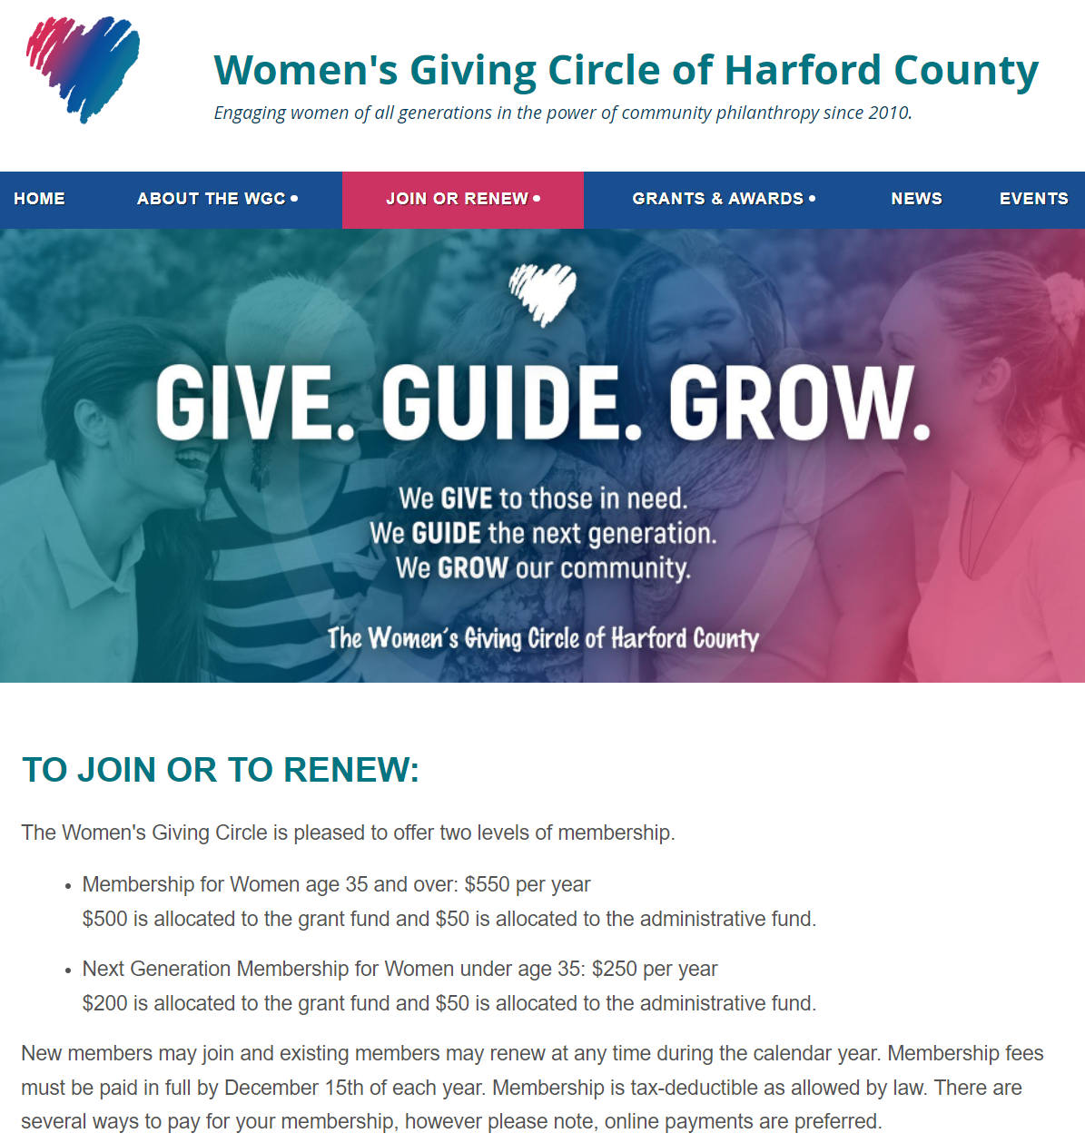
Membership Renewal
Four ways to renew:
  Credit Card or Bank Account
  Check
  Donor Advised Fund
  Direct Transfer / ACH Payment
Notes:
D2
If you just joined this year or have already paid in 2023, ignore this. If you haven’t renewed, there are three payment methods,

Slide 13
Upcoming Events
Save the Date
Grantee Showcase Meeting
  September 19
  Meet the 2023 grantees!
Impromptu Summer Ice Cream Social in the works with a grantee
  Watch our website/Facebook page/Newsletter for more information…..
Lunch visit to Chesapeake Therapeutic Riding
  October 6
  Meet this grantee’s team and learn of the good work they do!
Giving Tuesday Holiday Happy Hour
  November 28
  Announcement of the 2023 Members’ Choice Award!
  Members mix and mingle
Notes:
D2

Slide 14
Grant Committee Report
Hillary Smolenski
Notes:
Kelley introduce Hillary

Slide 15
2023 Grant Year Timeline
January 13 – Guidelines and application posted
January 23 – Pre-application meeting for potential applicants
February 3 – Grant Committee meeting
March 10 – Applications due
March 15 to April 19 – Individual reviews by Committee
April 21 – Committee meeting - discussion and recommendations
April 27 – Grantee recommendations to Board
May 11 - General membership meeting vote on grantee recommendations
End of May/June – Notification to grantees, funds disbursed, press release
Notes:
Hillary

Slide 16
Grant Process
Applications were reviewed and individually scored by Grant Committee members.
The Grant Committee met to discuss the applications as a group and to formulate a slate of recommendations to the Board.
The Board considered the recommendations from the Grant Committee and voted to approve.
The proposed grants are now presented to the general membership for approval.
Notes:
Hillary

Slide 17
Grant Process
Proposed grants approved by the general membership are submitted to Grapevine.
Grant agreements are executed and publicity photos are taken.
Grapevine issues the award.
Grantees are formally recognized at the Grantee Showcase Meeting on September 19, 2023.
Notes:
Hillary

Slide 18
Recommendations for 2023
Notes:
Sara and Sarah

Slide 19
Chesapeake Therapeutic Riding
Breathe Better at CTR
$3,849
The grant will cover the cost of (1) Micro Rain M25 water wheel. This device will reduce the amount of dust in the air, making riders and volunteers more comfortable.
Notes:
Hillary

Slide 20
CASA of Harford County
Tutoring Services
$5,000
This grant will provide tutoring services for children currently being served by CASA of Harford County.
Notes:
Hillary

Slide 21
The HOPE Center of Maryland, Inc
Beyond Blessings
$3,000
This grant will provide 75 low-income students with a backpack filled with shelf-stable meals to ensure students do not go hungry over weekends and during the holidays.
Notes:
Hillary

Slide 22
Girls on the Run of Central Maryland
Harford County Program Expansion Initiative
$5,000
GOTR will utilize grant funds to grow participation among Title 1 schools in Harford County. Additionally, they will purchase running shoes for any participant in need.
Notes:
Hillary

Slide 23
Homecoming Project
Life Skills Group
$5,000
This grant will cover the cost of a 20-week life skills group. Each group will include 8 participants and 1-2 licensed counselors.
Notes:
Hillary

Slide 24
Boys and Girls Club of Harford and Cecil Counties
Summer Camp
$5,000
Grant funds will be used to run a summer camp that is designed to promote and sustain learning in youth of all ages during the summer months.
Notes:
Hillary

Slide 25
The Forgotten Initiative -Harford
Life Skills 101
$2,000
This grant will be utilized for a weekly life skills class for transitional children (ages 14-21) in foster care. The classes will teach cooking, preparing a resume, finding affordable homes, financial literacy, and will help to identify career goals.
Notes:
Hillary

Slide 26
The Sexual Assault/Spouse Abuse Resource Center
Phelan Safehouse Client Needs
$5,000
This funding will allow SARC to purchase new car seats, strollers, and bedding and will provide childcare and ride share assistance.
Notes:
Hillary

Slide 27
The Sharing Table
Weekly Meal and Grocery Distribution
$5,000
This funding will provide meals and groceries to those in need in the Edgewood community.
Notes:
Hillary

Slide 28
Harford County Family Assistance Fund
$1,375
This program will provide 25 children who are entering into out-of-home care with luggage in order to help their transition go as smoothly as possible and to ensure that their special items come with them.
Notes:
Hillary

Slide 29
Improving Education
Bedtime in a Box
$5,000
This program will provide low-income families with books and healthcare materials to establish a nightly routine that supports their child’s health, sleep and early learning. Each box will have 4 age-appropriate books, bath wash, a towel, bath toys, toothbrush, toothpaste, pajamas, a stuffed animal, alarm clock, learning kit, and a kid-friendly routine log.
Notes:
Hillary

Slide 30
LASOS, Inc
Summer Program “On the Town Fridays”
$4,500
This funding will cover the cost to rent the Bel Air Armory on Fridays. This will allow LASOS to run their camp 5 days per week over the summer. Those being served by the camp are children aged 4-21 who are enrolled in school in Harford County who do not speak English as their first language.
Notes:
Hillary

Slide 31
Coming of Kings
Mentoring Program
$5,000
This grant will allow boys to meet with mentors each Sunday from 1-3 p.m. The program will include speakers and field trips with a focus on leadership development, college preparation, and work readiness.
Notes:
Hillary

Slide 32
2023 Grant Awards Proposed
$54,724 to 13 Deserving Applicants (*new recipient)
$3,849 $5,000 $5,000 $5,000 $5,000 $2,000 $5,000 $5,000 $1,375 $5,000 $4,500 $5,000 $3,000 | Chesapeake Therapeutic Riding, Inc. CASA of Harford County Girls on the Run of Central Maryland, Inc. Homecoming Project, Inc. Boys and Girls Club of Harford and Cecil Counties The Forgotten Initiative-Harford* The Sexual Assault/Spousal Abuse Resource Center The Sharing Table Harford County Family Assistance Fund Improving Education LASOS, Inc. Coming of Kings, Inc.* The HOPE Center of Maryland, Inc.
Notes:
Hillary
– ask for questions / discussion

Slide 33

Notes:
Donna

Slide 34
And the Grant Total for 2011 – 2023
Awards Is….
Notes:
Donna

Slide 35

$564,924.14
Notes:
Donna

Slide 36
Members’ Choice Award Update
Terri Garland
Notes:
Donna introduce Terri

Slide 37
Members’ Choice Award
Committee Members
  Terri Garland, Chair
  Jodi Marschhauser
  Kim Malat
  Tami Zavislan
Notes:
Terri

Slide 38
Members’ Choice Award
                Established in 2020
                Distribution from Endowed Fund held by the Community Foundation
                2022 Recipient:
                The Brandon Tolson Foundation
  $5,517.28
  Nominated by Debbie Lynch
  Planning underway for 4th award
  2023 Distribution = $5,991.61
Notes:
Terri

Slide 39
Communications Update
Debbie Lynch
Notes:
Donna introduce Debbie

Slide 40
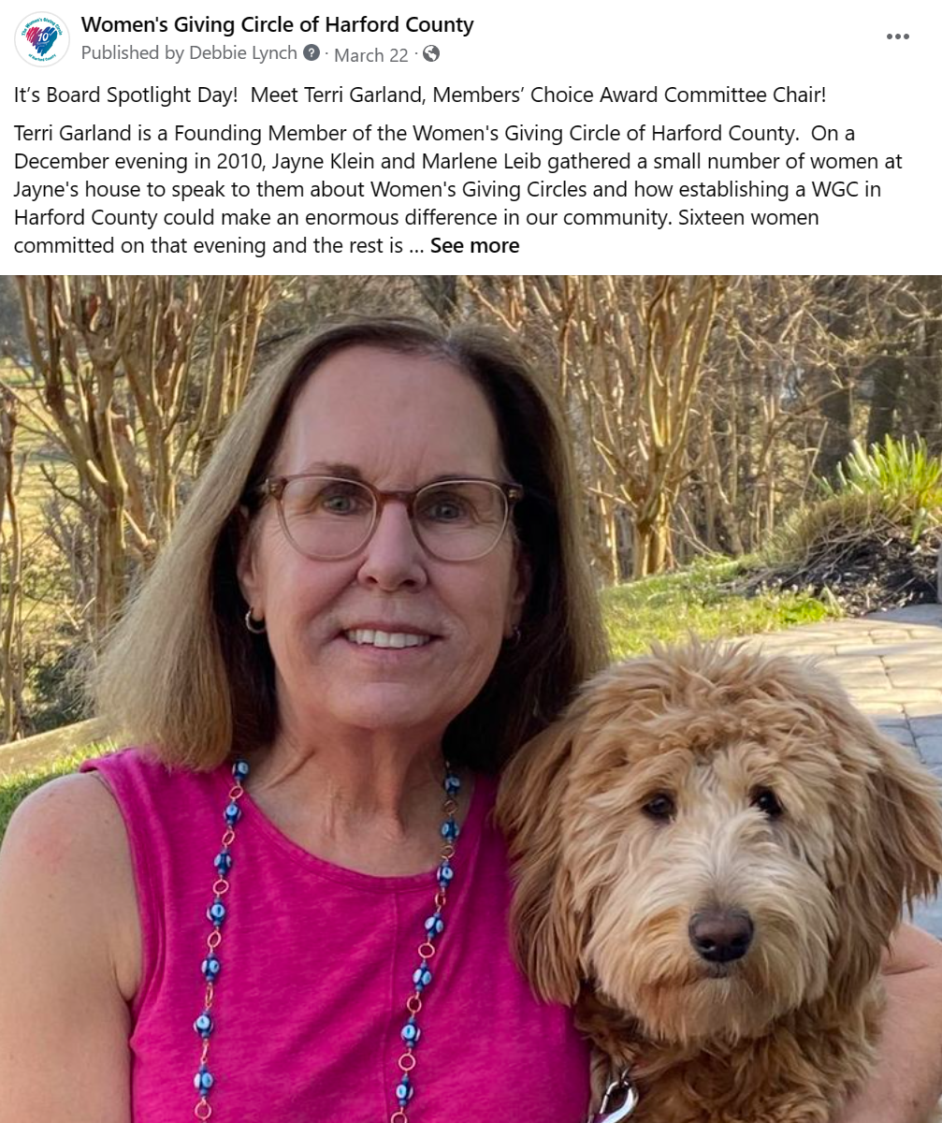
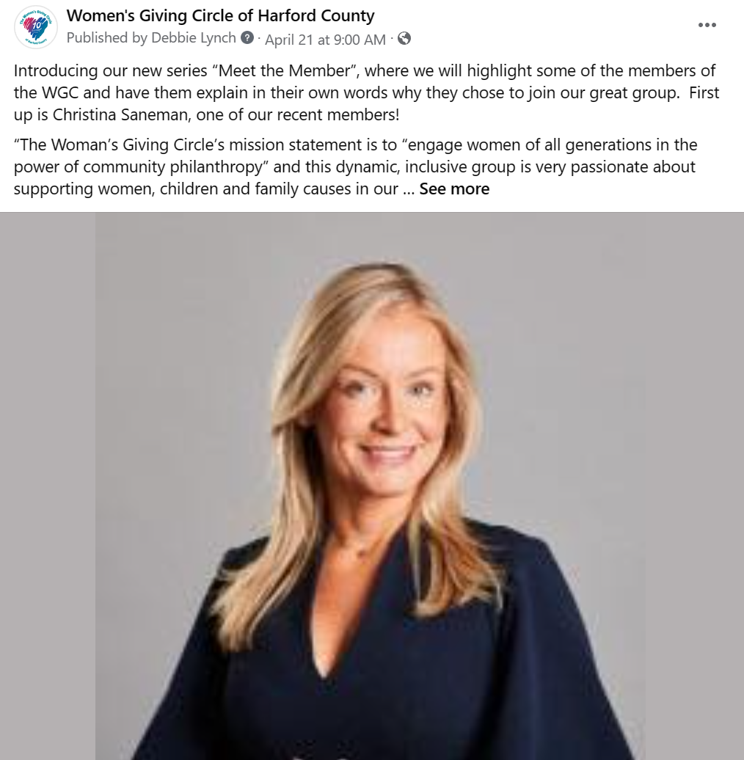
Stay Connected!
“Connect” with us on LinkedIn
“Like" the WGC Facebook page and “share” the posted news and events
  Consider being part of “Meet the Member”
Follow us on Instagram
Visit our website
Forward emails and posts to your philanthropic friends
Keep an eye on your Inbox for our monthly newsletter
Update your email address as needed so we can reach you!

Slide 41
Closing Remarks
Debbie Lynch
Notes:
Donna introduce Bonnie

Slide 42
Thank you!

