Slide 1
Notes:
Kim

Slide 2
Welcome!
Notes:
Kim

Slide 3
General Membership Meeting May 20, 2021
Opening Remarks
Donna Kreis
Finance Report
Monica Worrell
Grant Committee Report
Sara Burley / Sarah Ortiz-Brown
Member’s Choice Award Update
Tami Zavislan
Membership and Outreach Committee Report
Allison Cuneo
Closing Remarks
Bonnie Miranda
Notes:
Kim

Slide 4
2021-2022 Executive Board
Donna Kreis
Chair
Bonnie Miranda
Vice-Chair and Secretary
Monica Worrell
Treasurer
Kim Malat
Past Chair

Slide 5
2021-2022 Committee Chairs
Grant Committee Co-Chairs
Sara Burley
Sarah Ortiz-Brown
Membership and Outreach Committee Co-Chairs
Allison Cuneo
Donna Kahoe

Slide 6
2021-2022 Committee Chairs
10th Anniversary Committee
Robin Tomechko
Members’ Choice Award Committee Chair
Terri Garland
Notes:
Kim

Slide 7
Administrative Updates
Growfund Check Payment Changes
Administrative Fund Transfer to Faith Based Nonprofit Resource Center
COVID-19 Challenges
Wild Apricot Membership Management Software
WGC Info in One Place
Member Log-in
RSVP to Events
Newsletter and Other Communications
Notes:
Kim
Very pleased with Growfund
New processes make administration simpler

Slide 8
Administrative Updates
Updating Brochure for Prospective Members
WGC’s Publication in the first-ever Global Giving Circle Directory
Notes:
Kim
Very pleased with Growfund
New processes make administration simpler

Slide 9
Help Wanted
Photography / Video
Events
Committees
10th Anniversary – Co-Chair and Volunteers
Membership
Grants
Notes:
Kim

Slide 10
Circle Update – Grants to Date
10 Years
$402,067.30
122 Grants
53 Nonprofits serving women, families, and children in Harford County
Notes:
Kim

Slide 11
Finance Report
Monica Worrell
Notes:
Kim introduce Donna

Slide 12
Fund Balances
$159,065.15 Endowed Fund (as of 12/31/2020)
$ 4,639.58 for 2nd Members’ Choice Award
$43,515.56 Grant Fund for 2021 (official balance)
$9,709.92 Grant Fund for 2022 (as of 05/19/2021)*
$ 4,324.38 Administrative Fund (as of 5/19/2021)*
* Unofficial balance, subject to reconciliation
Notes:
Donna

Slide 13
BONUS GIVING $$$$$$$ 2021 Sponsorships and Donations
Increases Grant Pool & Reduces Expenses
Received to date:
$50 Gift to Administrative Fund
$100 Gift to Grant Fund
Future: Any time you choose to cover the fees as part of your annual contribution

Slide 14
Grant Committee Report
Sara Burley
Sarah Ortiz-Brown
Notes:
Donna introduce Rosemary

Slide 15
2021 Grant Year Timeline
January 11 – Guidelines and application posted
January 25 – Pre-application meeting for potential applicants
February 4 – Grant Committee meeting
March 12 – Applications due
March 17 to April 21 – Individual reviews by Committee
April 23 – Committee meeting - discussion and recommendations
April 28 – Recommendations to Board
May 20 – General membership meeting vote on recommendations
June – Notification to grantees, funds disbursed, press release
Notes:
Rosemary

Slide 16
Grant Process
Applications were reviewed and individually scored by Grant Committee members.
The Grant Committee met virtually to discuss the applications as a group and to formulate a slate of recommendations to the Board.
The Board considered the recommendations from the Grant Committee and voted to approve.
The proposed grants are now presented to the general membership for approval.
Notes:
Rosemary

Slide 17
Grant Process
Proposed grants approved by the general membership are submitted to Global Impact.
Global Impact provides final approval of the grants.
Global Impact issues payment.
Grant agreements are executed and publicity photos are taken.
Grantees are formally recognized at the10th Anniversary celebration on October 7, 2021.
Notes:
Rosemary

Slide 18
Recommendations for 2021
Notes:
Rosemary

Slide 19
Mason-Dixon Community Services
Summer Backpack Nutrition Program
$5,000
Children will bring home their backpacks filled with food items necessary for two weeks worth of breakfasts, lunches, and snacks from their new Kid’s Choice Pantry. Children will learn how to make their own food choices and how to combine two to three items to make one tasty meal or snack.
Notes:
Rosemary

Slide 20
Humanim, Inc.
Administrative Assistant Career Training Program (AACT)
$5,000
A 9-week training session for participants to earn two certifications: Microsoft Office Specialist and Professional Administrative Certificate of Excellence (PACE). Instruction will include emerging trends in remote-working, advanced professional “soft skills” development, wraparound and financial stability supports, and a 2-week administrative project assimilation.
Notes:
Rosemary

Slide 21
Faith Communities and Civic Agencies United, Inc.
$1,800
Funding 6 laptops (Chromebooks) at $300 each, as well as other necessary software to be used by the women who come through their program. The Chromebooks will provide the opportunity for the women to acquire an email account, complete interest and skill assessments, and job search.
Notes:
Rosemary

Slide 22
Homecoming Project
Shelter Support
$2,500
Ongoing shelter support and updating a number of household and yard accessories that have become worn/broken over the years. A shed, used by residents to store equipment used for yard upkeep, will be repaired by a program graduate.
Notes:
Rosemary

Slide 23
Harford Family House
Transportation for Families
$3,000
This project will enable HFH to work with single mothers with children who are in need of transportation to get to and from work, to take their children to and from daycare, after-school activities, doctor appointments, and any other trips needed via a bus pass, cab fare, and Uber rides.
Notes:
Rosemary

Slide 24
Boys and Girls Club
Club on the Go
$5,000
Club on the Go is a new initiative that will bring youth development programming and food access to under-resourced families in the high-need Edgewood and Aberdeen areas.
Notes:
Rosemary

Slide 25
Edgewood Community Support Center
Case Management
$5,000
Partial support for case manager’s salary to continue to connect individuals facing challenges due to financial, physical, and/or mental health issues with resources in the community.
Notes:
Rosemary

Slide 26
Harford County Education Foundation
Littles University
$4,978.40
HCEF has partnered with Harford County Public Schools to form “Littles University.” HCPS will release a video reading of an age-appropriate book where parents and children tune-in to participate in the reading on a monthly basis. In addition, HCEF ships the featured book to 250 children (birth to 5 years) each month.
Notes:
Rosemary

Slide 27
The Sexual Assault Spouse Abuse Resource Center Inc.
(SARC)
$5,000
Childcare and transportation assistance via Uber funds for 100 victims in total.
Notes:
Rosemary

Slide 28
Found in Faith Ministries
Sweet Dreams: Fresh Start Furniture Program
$2,737.16
Mattress covers and pillows
Notes:
Rosemary

Slide 29
Lions Association
Harford Hears
$3,500
Covers costs to provide hearing aids for low income Harford County applicants.
Notes:
Rosemary

Slide 30
2021 Grant Awards Proposed
$43,515.56 to 11 Deserving Applicants (*previous recipient)
$5,000 | Mason Dixon Community Services*
$5,000 | Humanim, Inc.
$1,800 | Faith Communities and Civic Agencies United, Inc.*
$2,500 | Homecoming Project*
$3,000 | Harford Family House*
$5,000 | Boys and Girls Club*
$5,000 | Edgewood Community Support Center*
$4,978.40 | Harford County Education Foundation*
$5,000 | Sexual Assault/Spouse Abuse Resource Center (SARC)*
$2,737.16 | Found in Faith Ministries*
$3,500 | Lions Association
Notes:
Rosemary – ask for questions / discussion

Slide 31
Notes:
Kim

Slide 32
And the Grant Total for 2011 – 2021 Awards Is….
Notes:
Kim

Slide 33
$445,582.86
Notes:
Kim

Slide 34
Members’ Choice Award Update
Tami Zavislan
Notes:
Kim introduce Tami

Slide 35
Members’ Choice Award
Committee Members
Terri Garland
Jodi Marschhauser
Kathi Santora
Tami Zavislan
Notes:
Tami

Slide 36
Members’ Choice Award
Established in 2020
Distribution from the Community Foundation’s Endowed Fund
2020 Recipient:
Harford County Family Assistance Fund
$4,735.54
Nominated by Marlene Lieb
Planning underway for 2nd award
2021 Distribution = $ 4,639.58
Notes:
Tami

Slide 37
Membership and Outreach Committee Report
“Alone, we can do so little. Together, we can do so much.”
-Helen Keller
Notes:
Tami introduce Lisa and Carol

Slide 38
Membership
On 1/1/21 we had 79 active members
As of 5/20/21 we have 89 active members (10 new members, including 2 Next Generation Members)
Goal as of 12/31/21 is to have in excess of 100 active members for 2021
Notes:
Lisa/Carol
Stress importance of membership – members = grants

Slide 39
The greater our membership, the greater our giving!
Do you have a friend, family member, or colleague that is interested in the Women’s Giving Circle?
Share with them power of women’s philanthropy!
We are neighbors helping neighbors!
Notes:
Lisa/Carol
Important to maintain a presence for membership

Slide 40
Watch your inbox, our website, and the WGC Facebook page for information about events to engage with considering members and prospective donors.
Co-workers, friends, relatives, neighbors, others ….
We love to grow awareness around what we do and how we help to strengthen our community.
Send an email to: WGCHarfordMembership@gmail.com
“The greatness of a community is most accurately measured by the compassionate actions of its members.” -Coretta Scott King
Notes:
Lisa/Carol

Slide 41
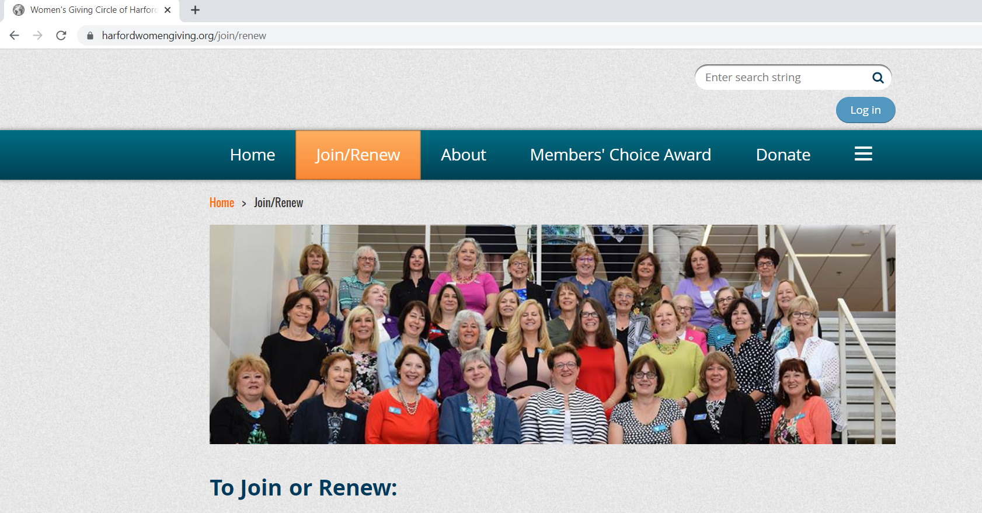
Membership
Two Levels of Membership
Membership for Women age 35 and over - $550 per year
$500 is allocated to the grant fund and $50 is allocated to the administrative fund
Next Generation Membership for Women under the age of 35 - $250 per year
$200 is allocated to the grant fund and $50 is allocated to the administrative fund
Notes:
Lisa/Carol

Slide 42
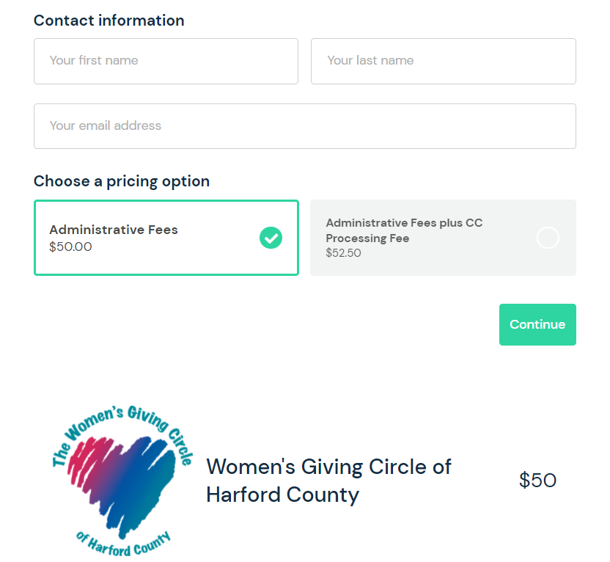
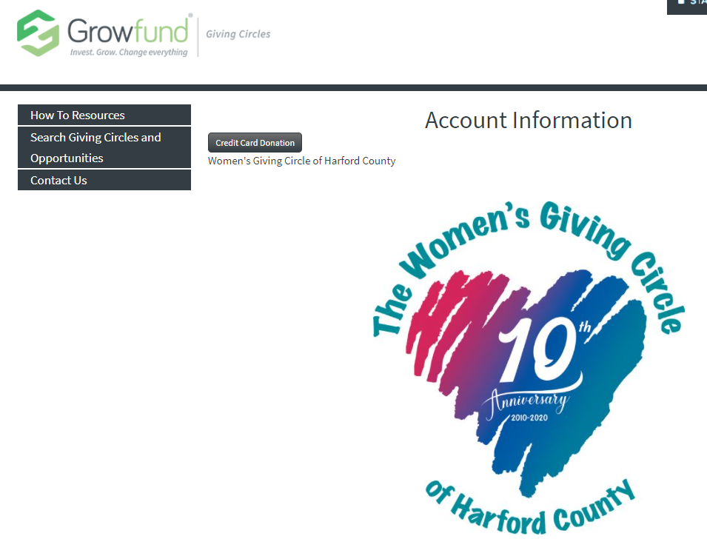
Giving Online in Two Steps
Step 1: Make your contribution to the grant fund via Growfund in the amount of $500/$200.
Step 2: Make your contribution to the administrative fund in the amount of $50 regardless of your membership level.
Credit Card Donation
Notes:
Lisa/Carol

Slide 43
Stay Connected!
Join a Committee
Join the Grants Committee to assist with reviewing applications and proposing selections for the upcoming year.
Join the Membership & Outreach Committee and help us to grow our WGC network.
Spread the Word
Attend events and bring a friend!
Promote the opportunity to apply for a grant through the WGC with local non-profits!
Share our story and mission across your personal and professional networks and encourage others to join!
Notes:
Lisa/Carol

Slide 44
Upcoming Meetings and Open House Events
June 17: Virtual Membership & Outreach Committee Meeting 6PM
July 15: In-Person Open House Event 6PM (Location TBA)
August 19: Virtual Membership & Outreach Committee Meeting 6PM
September 7: In-Person Open House Event 8:30AM (Location TBA)
October 19: Virtual Membership & Outreach Committee Meeting 6PM
November 4: In-Person Open House Event 6PM (Location TBA)
December 15: Deadline to join or renew membership for 2021
There is no power for change greater than a community discovering what it cares about. -Margaret J. Wheatley
Notes:
Kim

Slide 45
Upcoming Special Events
Save the Date
10th Anniversary Celebration
October 7 at the Vandiver Inn in Havre de Grace
Recognition of the 2020 and 2021 grantees
Giving Tuesday Holiday Happy Hour
November 30 from 5-7:30 pm
Maryland Golf & Country Club
Members only mix and mingle
Details to follow
Notes:
Kim

Slide 46
Closing Remarks
Notes:
Kim introduce Tami

Slide 47
Thank you!

