Slide 3
The Executive Board
Kim Malat, Chair
Tami Zavislan, Vice-Chair
Jodi Davis, Past Chair
Donna Kreis, Treasurer
Sara Burley, Secretary

Slide 4
Board Members
Grant Committee
Alice Welsh Leeds, Co-Chair
Rosemary King Johnston, Co-Chair
Membership and Outreach Committee
Lisa Fuller, Co-Chair
Carol Wright, Co-Chair
Communications
Jessica Moser

Slide 5
General Membership Meeting May 21, 2019
Opening Remarks
Circle Update – Good News and Opportunity
Kim Malat, Chair
Grant Committee Report
Vote on 2019 Proposed Grants
Alice Welsh Leeds, Committee Co-Chair
Membership Vote and Closing Remarks
Kim Malat, Chair

Slide 7
Circle Update - Grants
8 Years
$309,207.76 Awarded
96 Grants
45 Non-profit grantees serving women, families and children

Slide 8
Circle Update – Fund Balances
Balances as of 5/17/19, subject to reconciliation
$128,374.22 Endowed Fund
$43,904.12 Grant Fund
$3,482.70 Administrative Fund

Slide 9
Circle Update - Affiliations
“Catalist, formerly WCGN, the Women's Collective Giving Grantmakers Network, empowers women by supporting the creation, development and expansion of collective giving through informed grantmaking. We give a national voice to the high-impact collective giving movement and accelerate the power of our network of independent affiliate organizations.”
Catalist at a Glance:
More than 17,000 women strong
More than 60 member organizations worldwide
Granted more than $125 Million to nonprofit organizations throughout the U.S

Slide 10
Circle Update - Affiliations
Yearly participation in the Giving Circle Connector meeting attended by giving circle representatives from across the Mid-Atlantic region.
WGC hosted in 2015 and 2018

Slide 12
Circle Update: Administration
In early 2019, the Community Foundation unexpectedly notified us of several changes affecting the administration of our funds:
“Freezing” the admin fund;
New fund agreement for the grant fund with a new fee structure;
No grant making support for the grant committee.
Conscious of our fiduciary role, the Board had to make some difficult decisions quickly in order to fulfill the WGC’s mission and vision.
The first order was to ensure that the 2019 grant cycle would continue as planned and that the changes did not affect or impede this process.

Slide 13
Circle Update: Administration
The Board communicated the news to members via a mailed letter, followed by an email.
We know this caused confusion and some of you reached out with questions.
While the news was discouraging, the events presented the Board with opportunities.

Slide 14
The mission of the Women’s Giving Circle of Harford County is to engage women of all generations in the power of community philanthropy. The vision is to empower and mentor women as they develop in community leadership and effect change through collaborative giving.

Slide 15
Circle Update: Administration
Where We Are Today:
Continued dialog with the Community Foundation to resolve outstanding issues
Researched options for administration of our funds
Considered changes to our guidelines to be responsive to member suggestions

Slide 16
Our 2020 Vision
Maintain the endowed (Legacy) fund at the Community Foundation.
Create a Legacy Grant from the annual distribution of the endowed fund.
Allocate 100% of membership fees to the grant fund to accelerate the WGC’s impact.
Transfer the admin fund to Growfund
Establish the grant fund at Growfund

Slide 17
Our 2020 Vision
Maintain the endowed (Legacy) fund at the Community Foundation
Endowed fund is the Legacy Fund
Name recognizes the permanence of our collective philanthropy
Opportunity – Continue collaboration with the Community Foundation

Slide 18
Create a Legacy Grant from the annual distribution of the Legacy (endowed) fund
“Special grant” awarded each year that the Community Foundation sets a distribution
Opportunity – Design a unique grant that targets a need, fills a gap, etc.
Opportunity – Impact the community

Slide 19
Our 2020 Vision
Our 2020 Vision
To allocate 100% of membership fees to the grant fund
Responding to member input
Providing $11,000 to grant!
Opportunity – Do more!
Females 25-34, 55-64, and 18-24 are the 3 largest demographics living in poverty in Harford County*
30% of individuals experiencing homelessness on 1/22/18 were ages 0-17**
*Census Bureau, 2017
**2018 PIT Count, Office of Community & Economic Development)

Slide 20
Our 2020 Vision
Our 2020 Vision
To transfer the admin fund to Growfund
To establish the grant fund at Growfund
Transfer the admin fund as the Community Foundation can no longer administer
Growfund administers both funds
Opportunity – reduced fees, custom platform designed by giving circles for giving circles, real-time account access for members and the Board, greater transparency

Slide 21
Growfund for Giving Circles

Slide 22
Invest. Grow. Change Everything.

Slide 23
A leader in growing philanthropy for over 60 years
Global Impact builds partnerships and resources for the world’s most vulnerable people

Slide 24
Growfund
No-Minimum
Contributions and Grants in One Place
Hub of Services (coming soon!)
Digital Platform
Recurring Payments
Notes:
No-Minimum and only $25 to grant out
Digital Platform to Make Grants Immediately, Anywhere
Manage Your Own Contributions and Grants in One Place
501c3 status through Fiscal Sponsorship
Hub of Services (more to come on this)
Determine whether to include fiscal sponsorship

Slide 25
The Platform

Slide 26
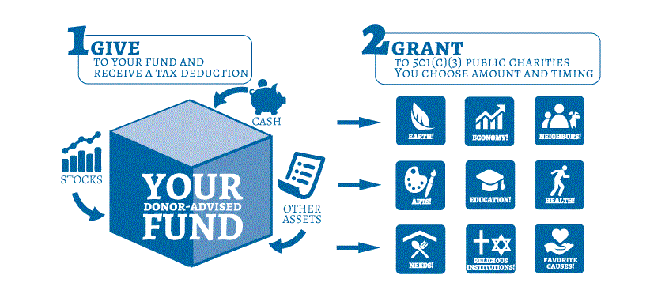
We are a Donor Advised Fund
Image: Coastal Community Foundation
Notes:
We are a donor-advised fund – it offers a way to grow your funds, if you choose through investments. Close to 70% of our funds are distributed out in the year that they are put in.
You can invest your money or choose a standard money market account, which is similar to a checking account. If you want to learn more about the investment options, stop by and talk to me.

Slide 27
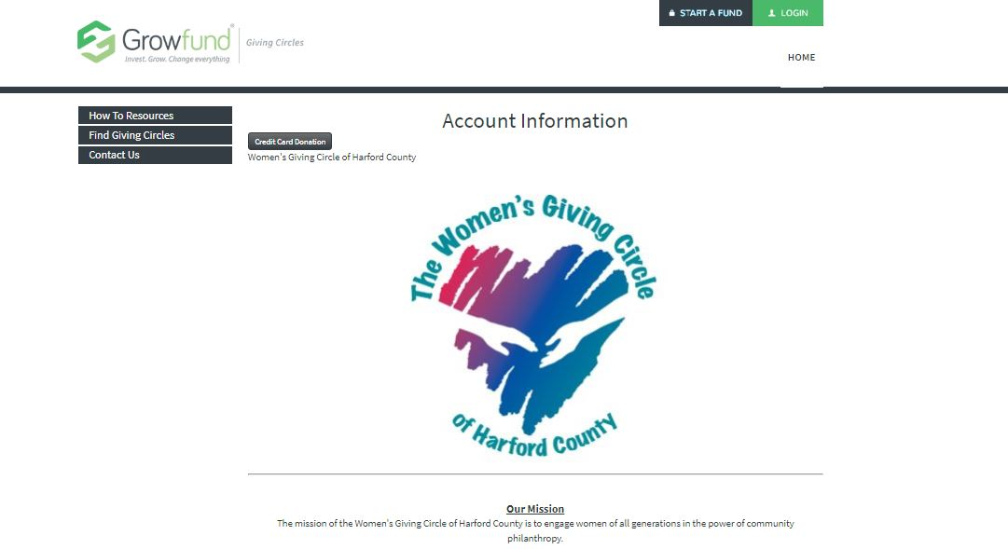
Find the Giving Circle
All members go to the WGC’s page to make a contribution
Real-time account access!

Slide 28
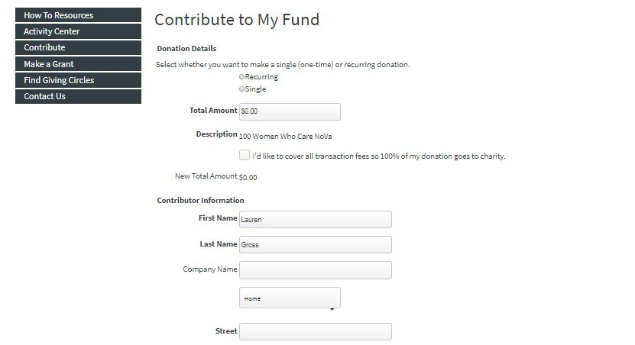
Determine Frequency and Amount
Recurring Payment Options
Monthly, quarterly, bi-monthly or annual recurring contributions
Make sure to enter correct amount!
Notes:
Contribute one-time or set up recurring payments.
Monthly, quarterly, bi-monthly or annual recurring contributions.
Members can select the day when recurring payments are made, ensuring that you get everyone’s contributions when needed to plan for matching gift submissions and presentations.

Slide 29
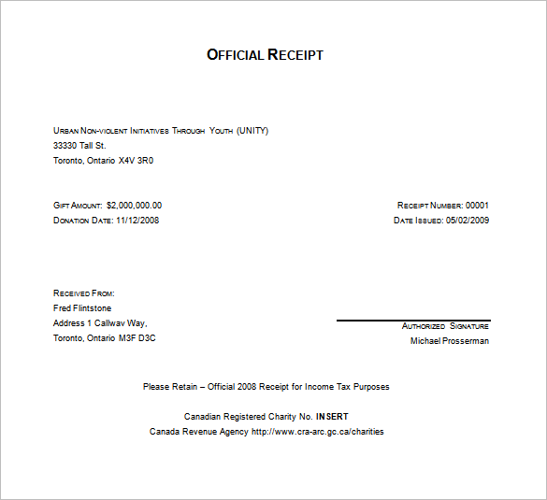
Instant Receipts!
Receive a tax eligible receipt
Notes:
All checks would be made to Global Impact.
We send a letter to nonprofits that includes each giving circle member’s information for acknowledgements.

Slide 30
Fees
Lowest out there!
1% distribution fee
1% check/e-check
3% credit card
Notes:
Give examples of different giving circles (charge four quarters)
Other platforms are there to either work as a bank or exist for nonprofits as a fundraising platform
3% credit card
1% bank fee – covers e-check, ACH, and paper checks (this is capped at $250 per contribution)
1% distribution fee
Covering the costs – different gcs do this different ways.

Slide 32
Questions?

Slide 33
Grant Committee Report Alice Welsh Leeds, Co-Chair

Slide 34
Grant Process
Applications were reviewed and individually scored by Grant Committee members.
The Grant Committee met to discuss the applications as a group and formulate a slate of recommendations to the Board.
The Board considered the recommendations from the Grant Committee and votes.
The proposed grants are presented to the general membership for approval.

Slide 35
Grant Process
Proposed grants approved by the general membership are presented to the Board of the Community Foundation.
The Community Foundation provides final approval of the grants.
Award letters are prepared and issued.
Grant agreements are executed and publicity photos are taken.
Grantees are formally recognized at the September general membership meeting.

Slide 36
Grant Committee Report
Recap of Applications Received Three-Year Rule Instituted in 2015
2011: 28 applications, 25 met the application criteria
2012: 20 applications, 19 met the application criteria
2013: 11 applications, all met the application criteria
2014: 28 applications, all met the application criteria
2015: 27 applications, all met the application criteria
2016: 29 applications, all met the application criteria
2017: 31 applications, 29 met the application criteria
2018: 31 applications, 29 met the application criteria
2019: 34 applications, 33 met the application criteria

Slide 37
2011 Grant Awards
$20,000 to 10 Deserving Recipients
$1,500 | The Arc Northern Chesapeake Region
$2,500 | Big Brothers Big Sisters (John Archer School)
$2,500 | Family & Children’s Services of Harford County
$2,500 | Harford Family House
$1,500 | The Highlands School
$1,000 | The Homecoming Project
$2,500 | LASOS
$1,500 | Tabitha’s House
$2,500 | Upper Bay Counseling & Support Services
$2,000 | Village at Lakeview Neighborhood Network

Slide 38
2012 Grant Awards
$35,400 to 11 Deserving Recipients (* 2nd year recipient)
$4,000 | The Arc Northern Chesapeake Region*
$4,000 | Boys & Girls Clubs of Harford County
$4,000 | CASA of Harford County
$2,500 | Family & Children’s Services of Harford County*
$3,000 | Habitat for Humanity Susquehanna
$3,500 | Harford Community Action Agency
$2,500 | Harford Family House*
$1,696 | The Highlands School*
$4,000 | Sexual Assault/Spouse Abuse Resource Center (SARC)
$3,850 | Upper Bay Counseling & Support Services*
$2,000 | Upper Chesapeake Health Foundation

Slide 39
2013 Grant Awards
$36,760.10 to 11 Deserving Recipients (*previous recipient)
$1,316 | The Arc Northern Chesapeake Region*
$4,000 | Associated Catholic Charities, Anna’s House
$4,000 | Birthright of Harford County
$3,000 | Children’s Center of North Harford
$4,000 | Harford Community Action Agency*
$2,485 | The Highlands School*
$4,000 | Homecoming Project, Inc.*
$2,459 | Making a Difference: Truancy Education
$3,500 | Sharon Ann Grose Educational Group (S.A.G.E.)
$4,000 | Sexual Assault/Spouse Abuse Resource Center (SARC)*
$4,000 | LASOS*

Slide 40
2014 Grant Awards
$20,000 to 8 Deserving Recipients (*previous recipient)
$3,000 | Arrow Child & Family Ministries
$2,945 | Chesapeake Therapeutic Riding
$3,000 | Hidden Jewel, Inc.
$1,441 | The Highlands School*
$3,000 | Homecoming Project, Inc.*
$3,000 | Making a Difference: Truancy Education*
$1,714 | Sexual Assault/Spouse Abuse Resource Center (SARC)*
$1,900 | Village at Lakeview Neighborhood Network Community Center

Slide 41
2015 Grant Awards
$43,081.78 to 11 Deserving Recipients (*previous recipient)
$4,000 | Arrow Child & Family Ministries*
$4,000 | Boys & Girls Clubs of Harford County*
$5,000 | CASA of Harford County*
$5,000 | Habitat for Humanity Susquehanna*
$4,800 | Harford Community Action Agency*
$2,960.78 | Harford Community College Foundation
$4,200 | Harford Family House*
$4,000 | Inner County Outreach
$3,250 | LASOS*
$3,500 | Mason-Dixon Community Services
$2,371 | Tabitha's House*

Slide 42
2016 Grant Awards
$45,750 to 14 Deserving Recipients (*previous recipient)
$1,500 | Anna’s House
$5,000 | Extreme Family Outreach
$2,250 | Girls on the Run of Harford and Cecil Counties
$5,000 | Habitat for Humanity Susquehanna*
$2,500 | Harford Community Action Agency*
$1,500 | Harford Family House*
$4,000 | Inner County Outreach*
$3,000 | JAMSQUAD
$5,000 | Ladew Gardens
$3,000 | LASOS*
$2,500 | New Day Wellness
$3,500 | Senior Express
$5,000 | Susquehanna Workforce Network
$2,000 | Village at Lakeview Neighborhood Network*

Slide 43
2017 Grant Awards
$53,500.88 to 15 Deserving Recipients (*previous recipient)
$5,000 | Taste Wise Kids
$3,000 | Harford Community Action Agency*
$2,500 | Habitat for Humanity Susquehanna*
$4,905.88 | JAMSQUAD Cycling*
$3,000 | Boys & Girls Club*
$3,000 | Girls on the Run of Harford and Cecil Counties*
$5,000 | Wilson Ministry Center
$5,000 | Greater Excellence in Education Foundation (GEEF)
$3,000 | Sexual Assault/Spouse Abuse Resource Center (SARC)*
$3,000 | Homecoming Project*
$5,000 | Ladew Gardens*
$2,000 | Harford Family House*
$1,500 | New Day Wellness*
$2,595 | Chesapeake Therapeutic Riding*
$5,000 | Char Hope

Slide 44
2018 Grant Awards
$54,715 to 16 Deserving Applicants (*previous recipient)
$5,000 | Boys and Girls Clubs of Harford County*
$4,000 | Char Hope Foundation*
$2,000 | Extreme Family Outreach*
$3,000 | Feel Your Boobies Foundation
$700 | Found in Faith Ministries
$2,850 | Girls on the Run of Harford and Cecil Counties*
$4,000 | Girl Scouts of Central Maryland
$5,000 | Harford County Education Foundation*

Slide 45
2018 Grant Awards Continued
$54,715 to 16 Deserving Applicants (*previous recipient)
$3,000 | Homecoming Project*
$4,000 | LASOS*
$3,500 | Mason-Dixon Community Services*
$3,665 | Sleep in Heavenly Peace
$1,500 | SPIN (New Day Wellness)*
$5,000 | TasteWise Kids*
$2,000 | The Sharing Table
$5,000 | The SUCCESS Project

Slide 46
2019 Grant Awards Proposed
$43,904 to 13 Deserving Applicants (*previous recipient)
$2,500 | Addiction Connections Resource, Inc.
$1,000 | Ben’s Wish Foundation
$4,000 | CASA of Harford County*
$1,500 | Faith Communities and Civic Agencies United
$5,000 | Girl Scouts of Central Maryland*
$5,000 | Harford Community Action Agency*
$5,000 | Harford County Education Foundation*
$5,000 | Homecoming Project*
$2,500 | Improving Education
$2,624 | JAMSQUAD Cycling*
$5,000 | TasteWise Kids*
$1,780 | The Sharing Table*
$3,000 | The SUCCESS Project*

Slide 47
2019 Grant Vote

Slide 48
And the Grant Total for 2011 – 2019 Is….

Slide 49
$353,111.76

Slide 50
Guidelines Vote

Slide 51
Guidelines Vote
Maintain the endowed (Legacy) fund at the Community Foundation
Create a Legacy Grant from the annual distribution of the endowed fund
To allocate 100% of membership fees to the grant fund
To transfer the admin fund to Growfund
To establish the grant fund at Growfund

Slide 52
Stay Connected!
“Like" the Women's Giving Circle of Harford County Facebook page and “share” the posted news and events.
Forward emails regarding these events to your philanthropic friends, and update your email address so that our emails reach you!

Slide 53
Calendar of Events
Happy Hour!
June 4th at Liberatores’ – 5 p.m.
July 17th at AleCraft Brewery – 5 p.m.
1st drink is on us for guests and members who bring a guest to introduce to us at happy hour!
Watch your inbox and Facebook for invitations!

Slide 54
Calendar of Events
General Membership Meeting
September 26, 2019
Harford Community College – 8 a.m.
Introduction of 2019 grant recipients
Please invite guests and remember to RSVP!
Watch your inbox and Facebook for invitations!

Slide 55
Closing Remarks

Slide 57
Creator: Paul Russel

