Slide 2
2019-2020
WGC Executive Board
Kim Malat, Chair
Tami Zavislan, Vice-Chair
Jodi Davis, Past Chair
Donna Kreis, Treasurer
Sara Burley, Secretary

Slide 3
2019-2020
WGC Committee Chairs
Grant Committee
Alice Welsh Leeds, Co-Chair
Rosemary King Johnston, Co-Chair
Membership and Outreach Committee
Lisa Fuller, Co-Chair
Carol Wright, Co-Chair
Communications
Jessica Moser

Slide 4
General Membership Meeting
September 26, 2019
Opening Remarks and Circle Update
Kim Malat, Chair
Presentation of the 2019 Grantees
Alice Welsh Leeds and Jodi Marschhauser
Grant Committee Report
Alice Welsh Leeds
Membership and Outreach Committee Report
Lisa Fuller and Carol Wright
Closing Remarks
Tami Zavislan, Vice-Chair

Slide 5


Circle Update - Grants
                9 Years
                $353,111.76
                109 Grants
                49 non-profits serving women, families, and children in Harford County

Slide 6

Fund Balances
                $128,396 Endowed Fund (as of 5/17/19)
                $7,633.12 Grant Fund (as of 9/25/19)
                $4,797.82 Administrative Fund (as of 9/25/19)
Balances Subject to Reconciliation

Slide 7
Administration
Completed Transfer to Growfund
Developed New Website
Secured New Mailing Address
Implemented Wild Apricot Membership Management Software
  WGC Info in One Place
  Member Log-in
  RSVP to Events
  Newsletters and Other Communication

Slide 8
Other Revenue
Increases grant pool and reduces expenses.
Sponsorships and non-member donations increased year-to-date:
$500 gift to grant fund
$500 gift restricted to Wild Apricot license
Holiday happy hour sponsorship

Slide 9
Help Wanted
Join or Renew!
Photography / Video
Events
Graphic Design
Committees
  10th Anniversary!

Slide 10
Presentation of the 2019 Grantees

Slide 11
ADDICTION CONNECTIONS
RESOURCE, INC.
Purpose: Teens Left Behind Project
Award: $2,500
Funds monthly grief support sessions for up to 12 teens who have lost a loved one due to substance abuse.

Slide 12
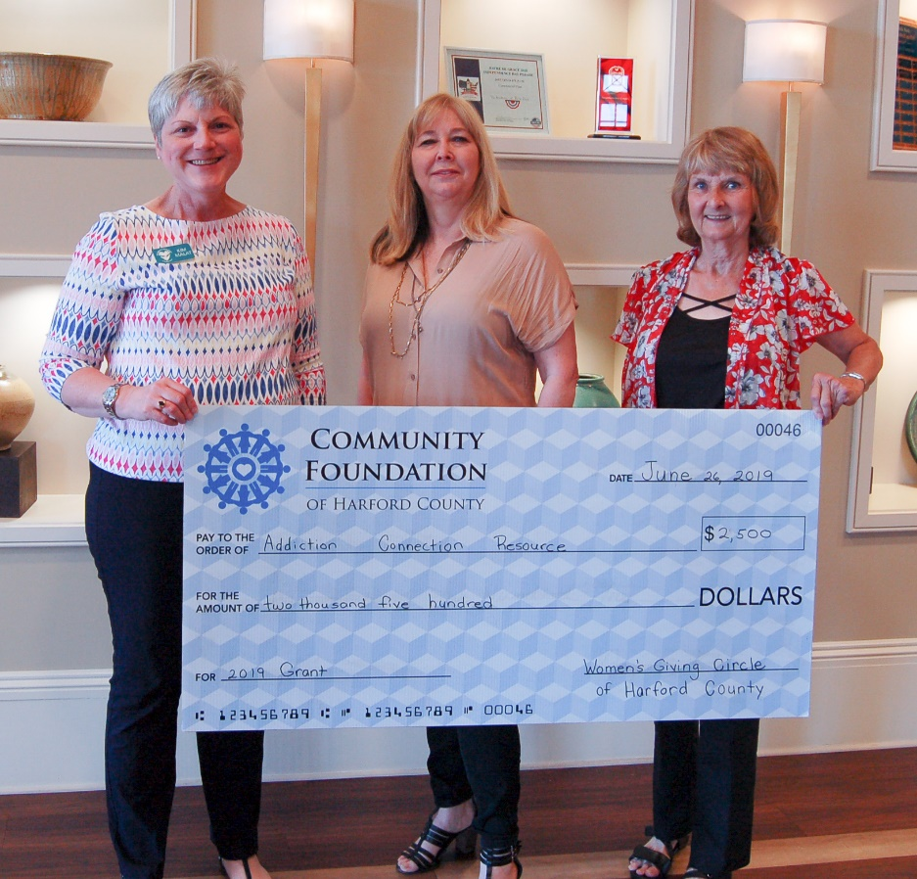
ADDICTION CONNECTIONS
RESOURCE, INC.

Slide 13
BEN’S WISH FOUNDATION
Purpose: Upper Chesapeake Health Care and Bereavement
Award: $1,000
Funds care and bereavement packages for up to 60 families with a sick child in the hospital and/or up to 50 families who have experienced the death of a child.

Slide 14
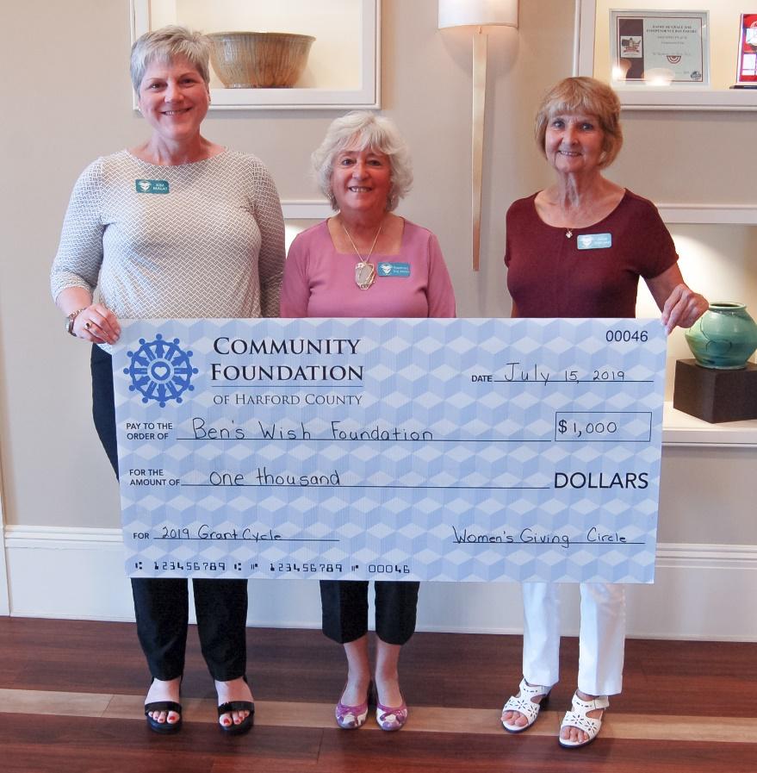
BEN’S WISH FOUNDATION

Slide 15
CASA OF HARFORD COUNTY
Purpose: Advocate and Youth Activity Fund
Award: $4,000
Provides 85-95 children and youth in foster care with necessities or outing expenses; tutoring and camp fees for at least 5 children; and partial support for a picnic for children in care and their foster and birth parents.

Slide 16
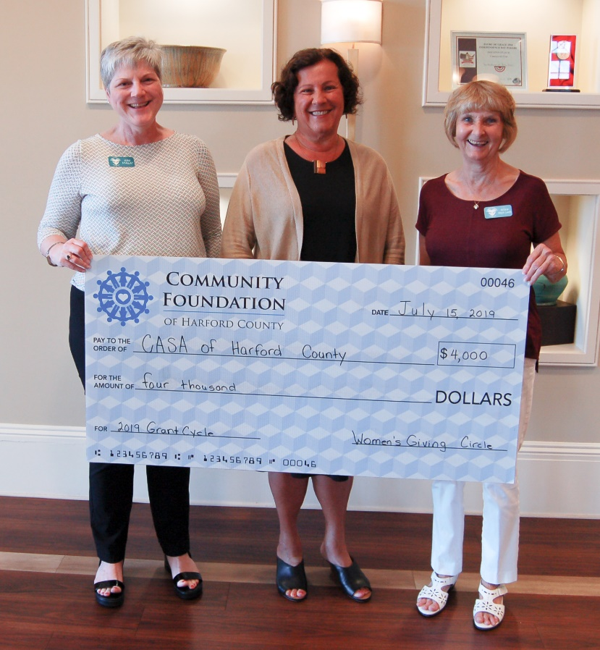
CASA OF HARFORD COUNTY

Slide 17
FAITH COMMUNITIES AND CIVIC
AGENCIES UNITED
Purpose: Welcome One Emergency Shelter
Award: $1,500
Provides partial support for shelter case manager’s salary to work to secure permanent housing for residents.

Slide 18
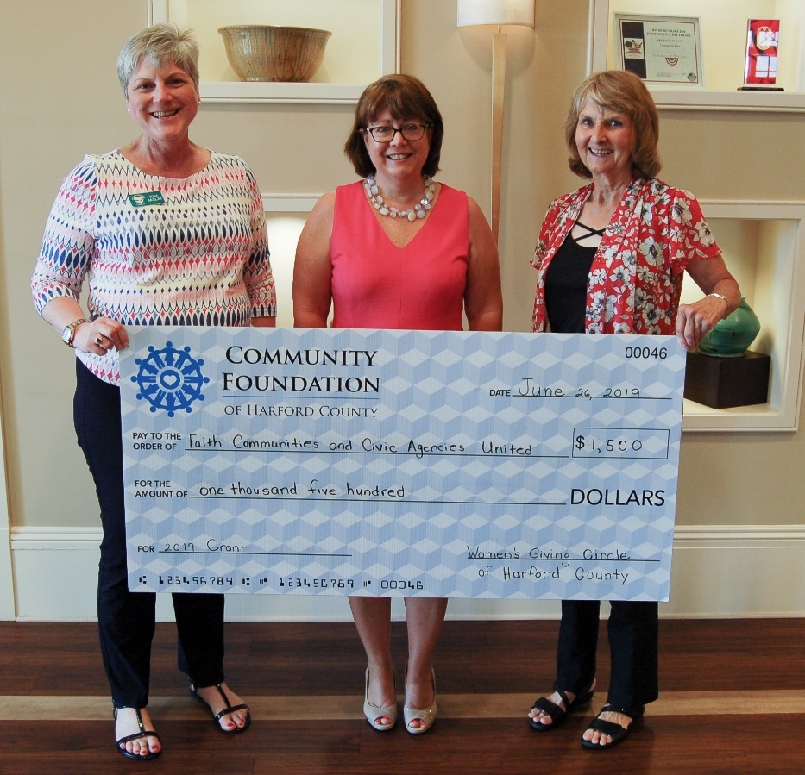
FAITH COMMUNITIES AND CIVIC
AGENCIES UNITED

Slide 19
GIRL SCOUTS OF CENTRAL MARYLAND
Purpose: Rockin’ Robotics
Award: $5,000
Supports all-girl robotics teams for competitions and STEM expos. Serves 64 girls in grades 1-5 at four Title 1 schools.

Slide 20
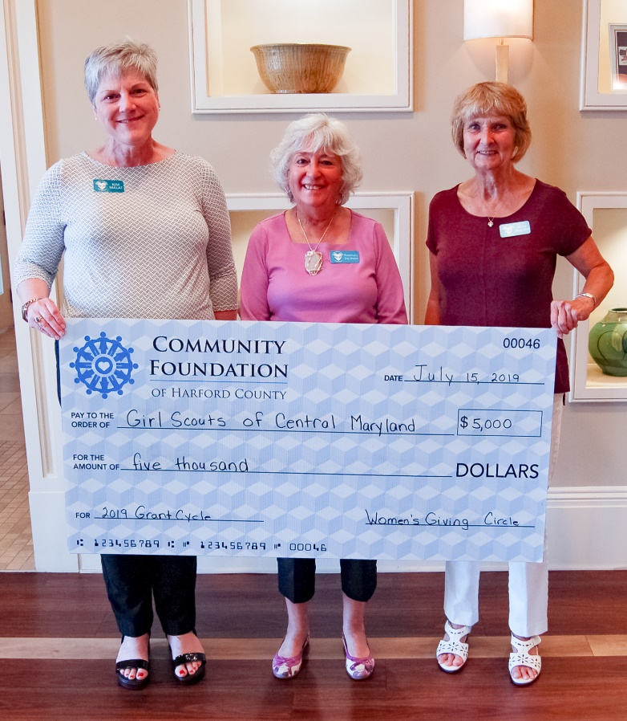
GIRL SCOUTS OF CENTRAL MARYLAND

Slide 21
HARFORD COMMUNITY ACTION AGENCY
Purpose: Family Together: Maintaining Shelter through Crises
Award: $5,000
Provides $500 toward security deposit for families to transition from temporary to permanent housing. Will assist 10 female-headed households living in hotels or motels.

Slide 22
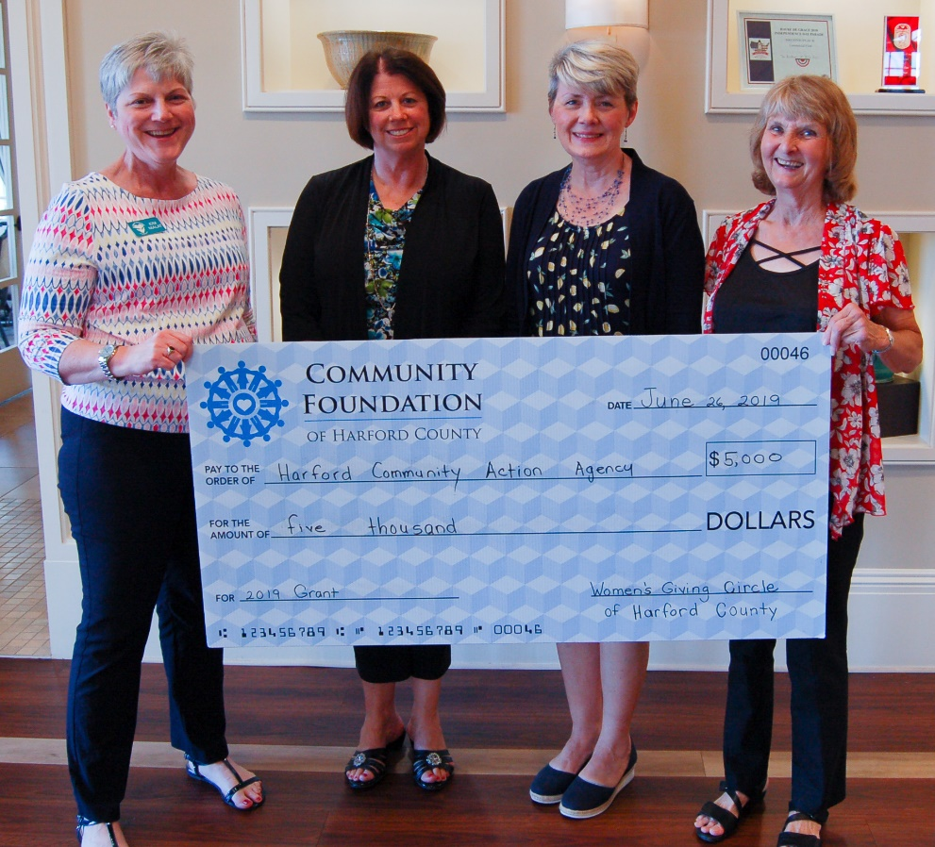
HARFORD COMMUNITY ACTION AGENCY

Slide 23
HARFORD COUNTY EDUCATION FOUNDATION
Purpose: One Harford, One Book
Award: $5,000
Provides one chapter book to 3,060 families with 4,364 children in grades K-5 in eight Title 1 schools to incorporate family reading, build reading proficiency, and address “summer slide” - the loss and regression of reading skills during summer break.

Slide 24
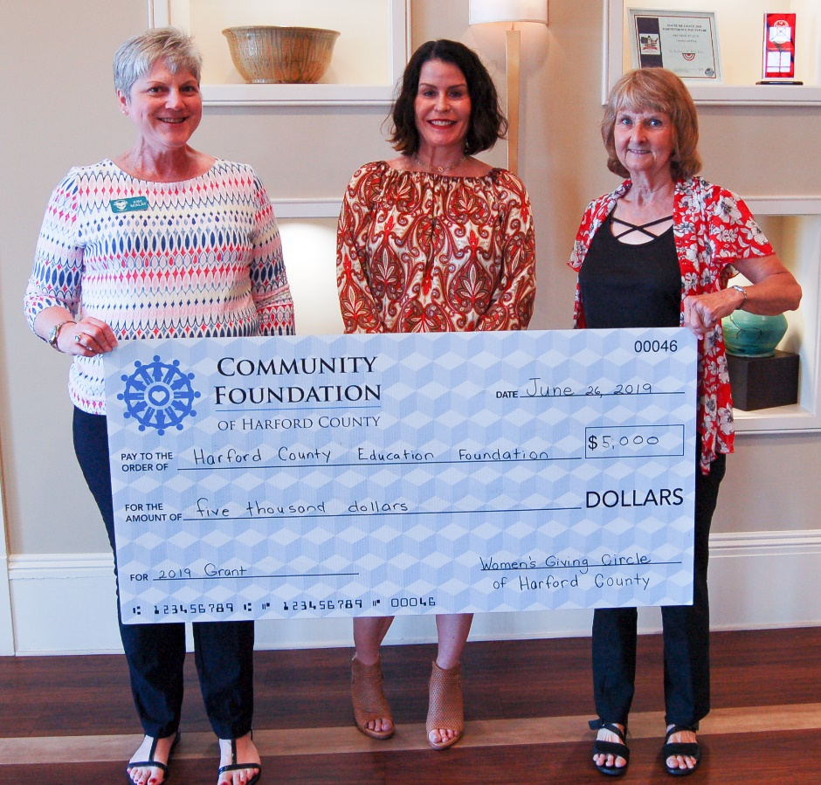
HARFORD COUNTY EDUCATION FOUNDATION

Slide 25
HOMECOMING PROJECT
Purpose: Shelter Support for Food and Household Items
Award: $5,000
Provides funding for 1,200 meals, personal products, and cleaning supplies for a 12-month, 8 bed residential program for low income women in recovery from substance abuse.

Slide 26
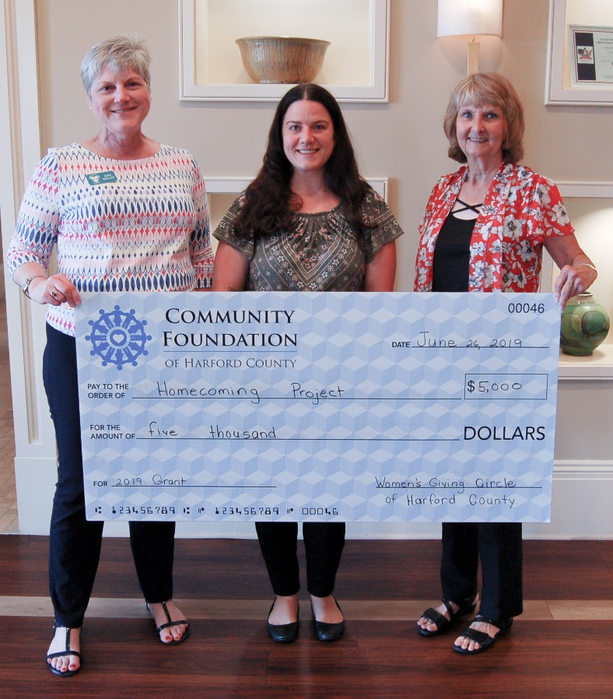
HOMECOMING PROJECT

Slide 27
IMPROVING EDUCATION
Purpose: Bedtime in a Box
Award: $2,500
Provides bedtime boxes to 50 preschool age children and their families who attend the Judy Center at Magnolia Elementary School to implement a comprehensive bedtime routine to improve early literacy.

Slide 28
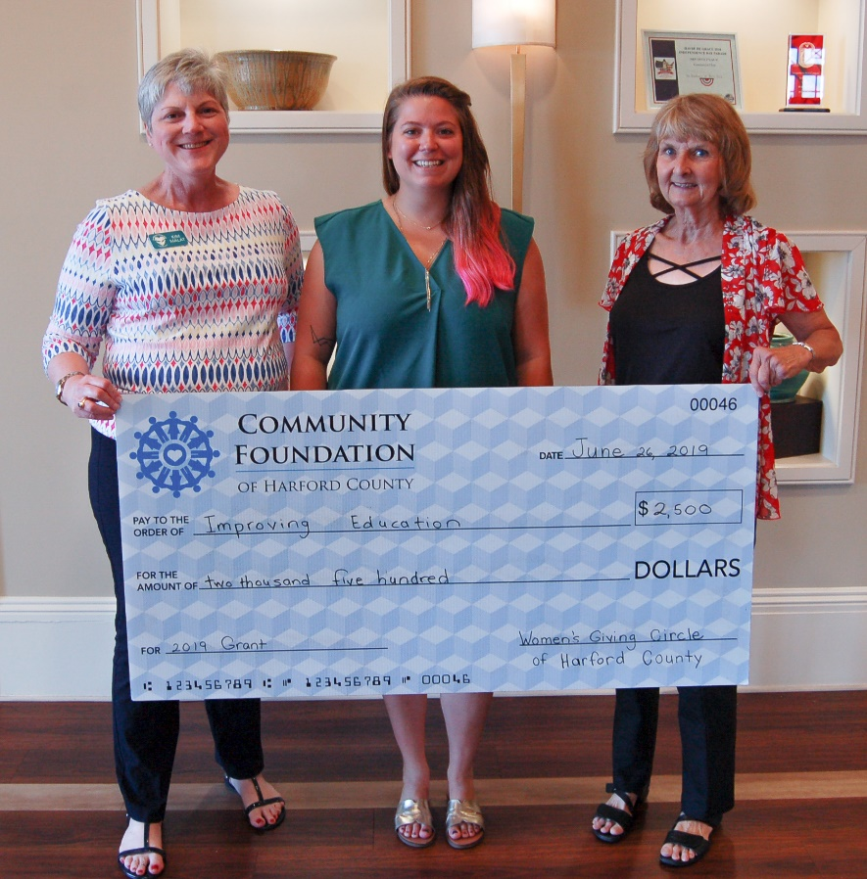
IMPROVING EDUCATION

Slide 29
JAMSQUAD CYCLING
Purpose: One Community, Two Wheels
Award: $2,625
Funds the purchase of family supply bags, repair parts, and shop supplies to provide 250 refurbished bicycles to children in two communities and to women in recovery.

Slide 30
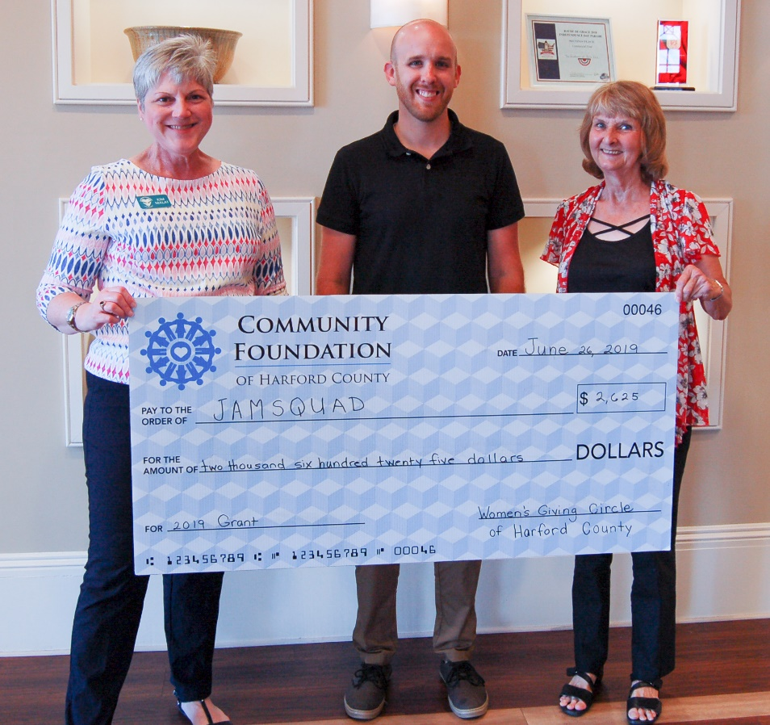
JAMSQUAD CYCLING

Slide 31
TASTEWISE KIDS
Purpose: Days of Taste
Award: $5,000
Supports hands-on nutrition and food prep classes with a chef, a field trip to a working farm, and take-home salad kits for 150-200 4th graders at Havre de Grace and Halls Crossroads Elementary Schools.

Slide 32
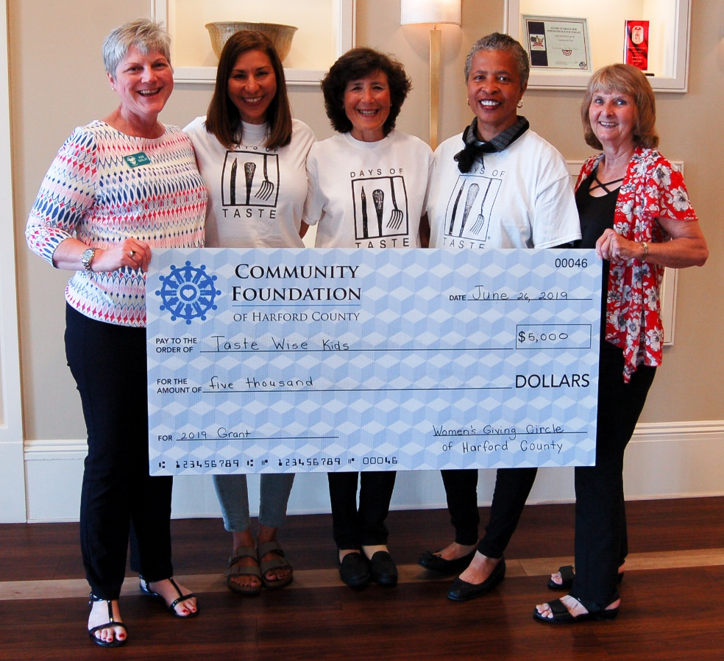
TASTEWISE KIDS

Slide 33
THE SHARING TABLE
Purpose: Weekly Meal and Grocery Distribution
Award: $1,780
Supports a weekly communal meal and bag of groceries, paper goods, etc., to women in the Edgewood, Joppa, and Aberdeen areas. Serves over 2,300 women and 562 children.

Slide 34
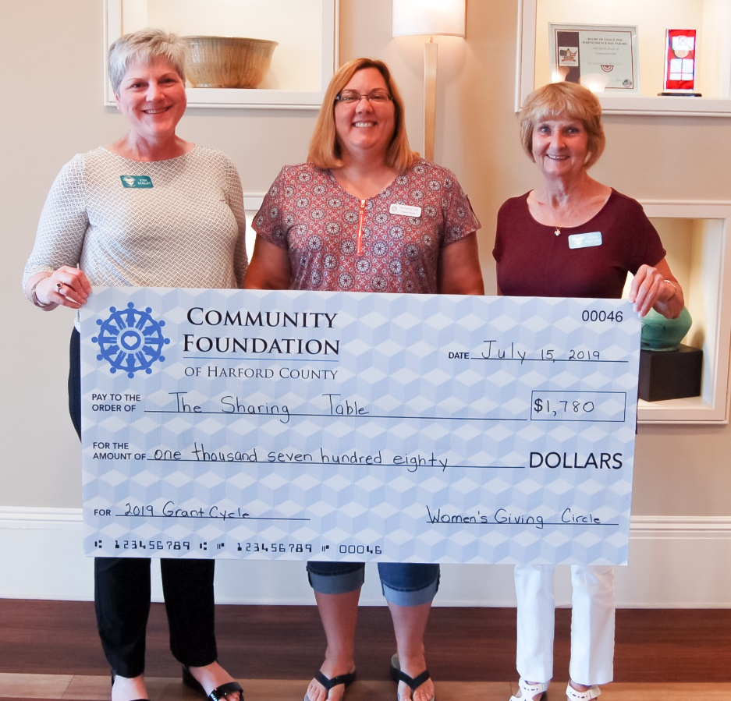
THE SHARING TABLE

Slide 35
THE SUCCESS PROJECT
Purpose: SUCCESS Transportation and Child Care
Award: $3,000
Employs a van driver to transport children and mothers/female guardians to three SUCCESS workshops/resource opportunities each month and supports a child care facilitator for educational activities.

Slide 36
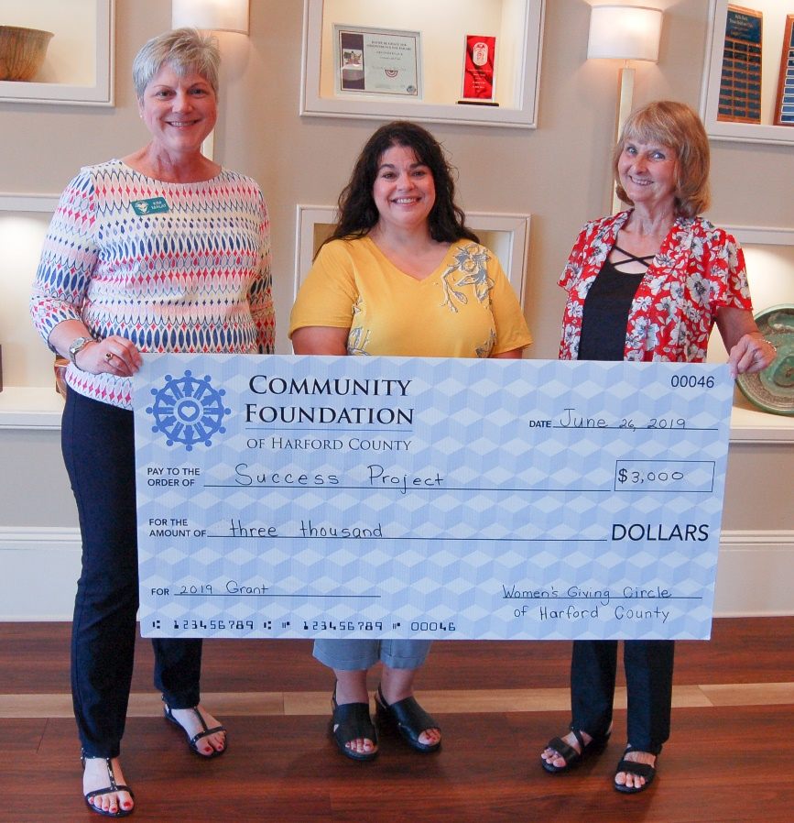
THE SUCCESS PROJECT

Slide 37
Grant Committee Report

Slide 38
2019 Grant Cycle
34 Applications, 33 Met Review Criteria
11 Grant Committee Reviewers
13 Awards Totaling $43,904
  9 Previous Grantees
  4 New Grantees
And the grand total for 2011 – 2019 is:

Slide 39

$353,111.76

Slide 40
Membership and Outreach Committee Report

Slide 41
The greater our membership, the greater our giving!
Do you have a friend, family member or colleague that is interested in the Women’s Giving Circle?
Share with them power of women’s philanthropy!
Send an email to: WGCHarfordMembership@gmail.com

Slide 42
Membership Drive!
Next event is October 24, 2019 at Liberatore’s from 5-7:30 p.m.
1st drink is on us for guests and members who bring a guest to introduce to us that night!
Join or renew between September 22 and October 24 to be entered to win our next raffle.
Watch your inbox and Facebook for invitations!

Slide 43
Time to Renew!
Renewal letter and invoice will be sent shortly:
  Emailed through Wild Apricot
  Copies on the sign-in table
Please respond by December 15, 2019 for your membership contribution to be included in the next grant cycle.

Slide 44
To Renew:
Go to the “Join” page of our website at: www.wgchco.wildapricot.org
Options:
  Credit Card
  Electronic Check
  Paper Check
Instructions online and on sign-in table

Slide 45
T-Shirts!
Show your WGC pride when in the community
Wear when volunteering as a group.
Order today at sign-in table.
Teal with white lettering
$20 each

Slide 46
Holiday Happy Hour
Save the Date
December 3, 2019 from 5 p.m. to 7:30 p.m. .
Maryland Golf and Country Club in the Bel Air Room
Members only mix and mingle.
Watch your inbox and Facebook for invitations!

Slide 47
Stay Connected!
“Like" the WGC Facebook page and “share” the posted news and events.
Follow us on Instagram.
Visit our website.
Forward emails and posts to your philanthropic friends.
Update your email address as needed!

Slide 48
Closing Remarks

