Slide 1
Grantee Showcase September 14, 2022
Notes:
Donna

Slide 2
2021-2022 Executive Board
Donna Kreis
Chair
Bonnie Miranda
Vice-Chair and Secretary
Monica Worrell
Treasurer
Kim Malat
Past Chair
Notes:
Donna

Slide 3
2021-2022 Committee Chairs
Grant Committee Chair
Sara Burley
Membership and Outreach Committee Co-Chairs
Allison Cuneo
Donna Kahoe
Notes:
Donna

Slide 4
2021-2022 Committee Chairs
Members’ Choice Award Committee Chair
Terri Garland
Notes:
Donna

Slide 5
Help Wanted
New Executive Board in January 2023
Committees
Membership and Outreach
Grant
Communications
Photography / Video
Philanos PowerUp! Conference – Fall 2023
Notes:
Donna
Philanos - LEADING NATIONAL WOMEN'S GIVING CIRCLE NETWORK
- Baltimore, MD
- Teaming with local giving circles to support

Slide 6
Finance Report
Monica Worrell
Notes:
Donna to Introduce Monica

Slide 7
Fund Balances
$142,319.73 Endowed Fund (as of 6/30/2022)
$5,517.28 for 3rd Members’ Choice Award
$15,486.28 Grant Fund for 2023 (as of 9/12/2022)
$460.52 Administrative Fund (as of 9/12/2022)
Notes:
Monica
Endowed Fund – Down $17K from last June
So far in 2022……
$150 Matching Donations
$50 Donation in Memory of Relative

Slide 8
2022 Grantees
Sara Burley
Notes:
Monica introduce Sara

Slide 9
2022 Grant Awards
$54,460.50 to 14 Deserving Applicants (*new recipient)
$3,188 $2,000 $5,000 $3,200 $3,000 $5,000 $3,500 $3,000 $3,500 $5,000 $5,000 $3,072.50 $5,000 $5,000 | Chesapeake Therapeutic Riding, Inc. Ed Lally Foundation* Edgewood Community Support Center (EPICENTER) Found In Faith Ministries Girls on the Run Central Maryland Habitat for Humanity Susquehanna Harford County Education Foundation Harford Family House Homecoming Project Humanim LASOS, Inc. Mason Dixon Community Services Sleep in Heavenly Peace, Inc. TasteWise Kids
Notes:
Sara and Sarah
– ask for questions / discussion

Slide 10
Chesapeake Therapeutic Riding
Safe Hearts at CTR 2022
$3,188
Will cover the cost for 2 onsite automated external defibrillators (AEDs) & 1 pediatric pack.
Notes:
Sara and Sarah

Slide 11
Ed Lally Foundation Inaugural Harford County Women's Mindfulness Retreat
$2,000
Supports mental health & suicide prevention for 30 women. The funds will be used to support staff in the development and administration of the retreat and day of event expenses - location, materials, and food. They will host a virtual monthly support group throughout the following year until the next retreat in 2023.
Notes:
Sara and Sarah

Slide 12
Edgewood Community Support Center
Case Management
$5,000
Support for the case manager’s salary. The case manager connects individuals facing challenges due to financial, physical, and/or mental health issues with resources in the community at their new, second location, in Aberdeen.
Notes:
Sara and Sarah

Slide 13
Found in Faith Ministries
Transportation Scholarship Applicants
$3,200
Found in Faith Ministries seeks to increase funding available for their Transportation Scholarship applicants. They anticipate being able to serve approximately 24 more Harford County families, increasing their service provision by 10-15% with the support of the WGC.
Notes:
Sara and Sarah

Slide 14
Girls on the Run
$3,000
An emotional support training program for girls ages 8-13. We will fund everything needed for one season for up to 15 girls.
Notes:
Sara and Sarah

Slide 15
Habitat for Humanity Susquehanna
Empowering Women Through Shelter
$5,000
Grant funds will be used towards construction costs for homes in Havre de Grace – the last duplex in the Revolution/Stokes community and a duplex on Erie Street.
Notes:
Sara and Sarah

Slide 16
Harford County Education Foundation
Littles University
$3,500
HCEF has partnered with Harford County Public Schools to form “Littles University.” HCPS will release a video reading of an age-appropriate book and parents and children tune-in to participate in the reading on a monthly basis. In addition, HCEF ships the featured book to 250 children (birth to 5 years) each month.
Notes:
Sara and Sarah

Slide 17
Harford Family House
Child Care
$3,000
This funding will enable Harford Family House to provide direct financial assistance to families experiencing homelessness to address their childcare needs through a partnership with the Boys & Girls Clubs and local daycare providers. Services will be mostly in Aberdeen and along the Rt 40 corridor.
Notes:
Sara and Sarah

Slide 18
Homecoming Project
Life Skills Group
$3,500
Requesting WGC funding as part of the ongoing expense of shelter support, but specifically to cover the cost of 20 weeks of a life skills group.
Notes:
Sara and Sarah

Slide 19
Humanim, Inc.
Infinity Center for Behavior Services of Harford County
$5,000
Humanim is requesting funds to assist with the purchase of therapy equipment and reinforcers. The therapy equipment/reinforcers they utilize to engage and educate children is at the crux of ABA therapy. Examples of equipment include puzzles, play kitchen equipment, and play tool benches.
Notes:
Sara and Sarah

Slide 20
LASOS, Inc.
Summer Program "Open up to the Community"
$5,000
LASOS, Inc. hosts an academic and youth development program designed for non-native English speaking students to come to the LASOS office or to meet at their home schools to receive homework support, mentoring, and increase technology skills.
Notes:
Sara and Sarah

Slide 21
Mason-Dixon Community Services
Senior Outreach Program
$3,072.50
The Senior Outreach Program will provide food services as a continuation of a program started during COVID-19. Food services will include an abundance of produce as well as dairy products and frozen meats to seniors throughout their service area on a quarterly basis.
Notes:
Sara and Sarah

Slide 22
Sleep in Heavenly Peace No Kid Sleeps on the Floor in Our Town! - Harford Co. Chapter
$5,000
WGC support of $5,000 will enable the MD-Harford Chapter to purchase necessary supplies and materials to provide 18 (of their one hundred bed goal in 2022) fully furnished twin beds for children without beds in Harford County.
Notes:
Sara and Sarah

Slide 23
TasteWise Kids
Days of Taste at Havre de Grace Elementary School
$5,000
WGC funds will support all costs associated with providing the Days of Taste program at Havre de Grace Elementary School in the Spring of 2023. The program consists of three mornings spaced over 2-3 weeks.
Notes:
Sara and Sarah

Slide 24
Circle Update – Grants to Date
12 Years
$ 504,682.86
148 Grants
57 Nonprofits serving women, families, and children in Harford County
Notes:
Donna

Slide 25
Members’ Choice Award Update
Terri Garland
Notes:
Donna introduce Terri

Slide 26
Members’ Choice Award
Committee Members
Terri Garland, Chair
Jodi Marschhauser
Kim Malat
Tami Zavislan
Notes:
Terri

Slide 27
Members’ Choice Award
Established in 2020
Distribution from Endowed Fund held by the Community Foundation
2021 Recipient:
Miracle League of Harford County
$4,639.50
Nominated by Julie Chmura
Planning underway for 3rd award
2022 Distribution = $5,517.28
Notes:
Terri

Slide 28
Membership and Outreach Committee Report
“Alone, we can do so little. Together, we can do so much.”
-Helen Keller
Notes:
Terri introduce D2

Slide 29
Membership and Outreach Committee Members
Donna Kahoe & Allison Cuneo, Co-Chairs
Judy Antisdel
Maria Dontas
Terri Garland
Susan Humphries
Rosemary King Johnston
Karen Kukurin
Notes:
D2
Stress importance of membership – members = grants

Slide 30
Membership
On 1/1/22, we had 109 active members
As of 9/12/22, we have 116 active members
6 Next Generation members
2022 Goals:
Reach 140 active members by 12/15/2022
Welcome 30 new members
Notes:
D2
Stress importance of membership – members = grants
New Members in 2022:
Deborah Stathes
COL (R) Warline Bryant
Beverly Sgroi
Linda Flint
Jennifer Farrell
Barbara Boniface
Debi Buta

Slide 31
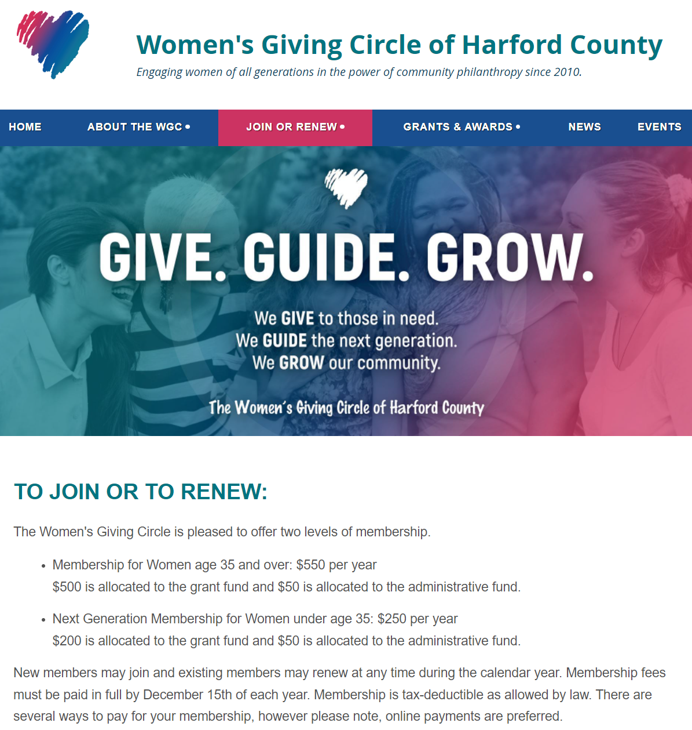
Membership
Two Levels of Membership
Membership for Women age 35 and over
$550 per year
$500 to grant fund
$50 to administrative fund
Next Generation Membership for Women under the age of 35
$250 per year
$200 to grant fund
$50 to administrative fund
Notes:
D2

Slide 32
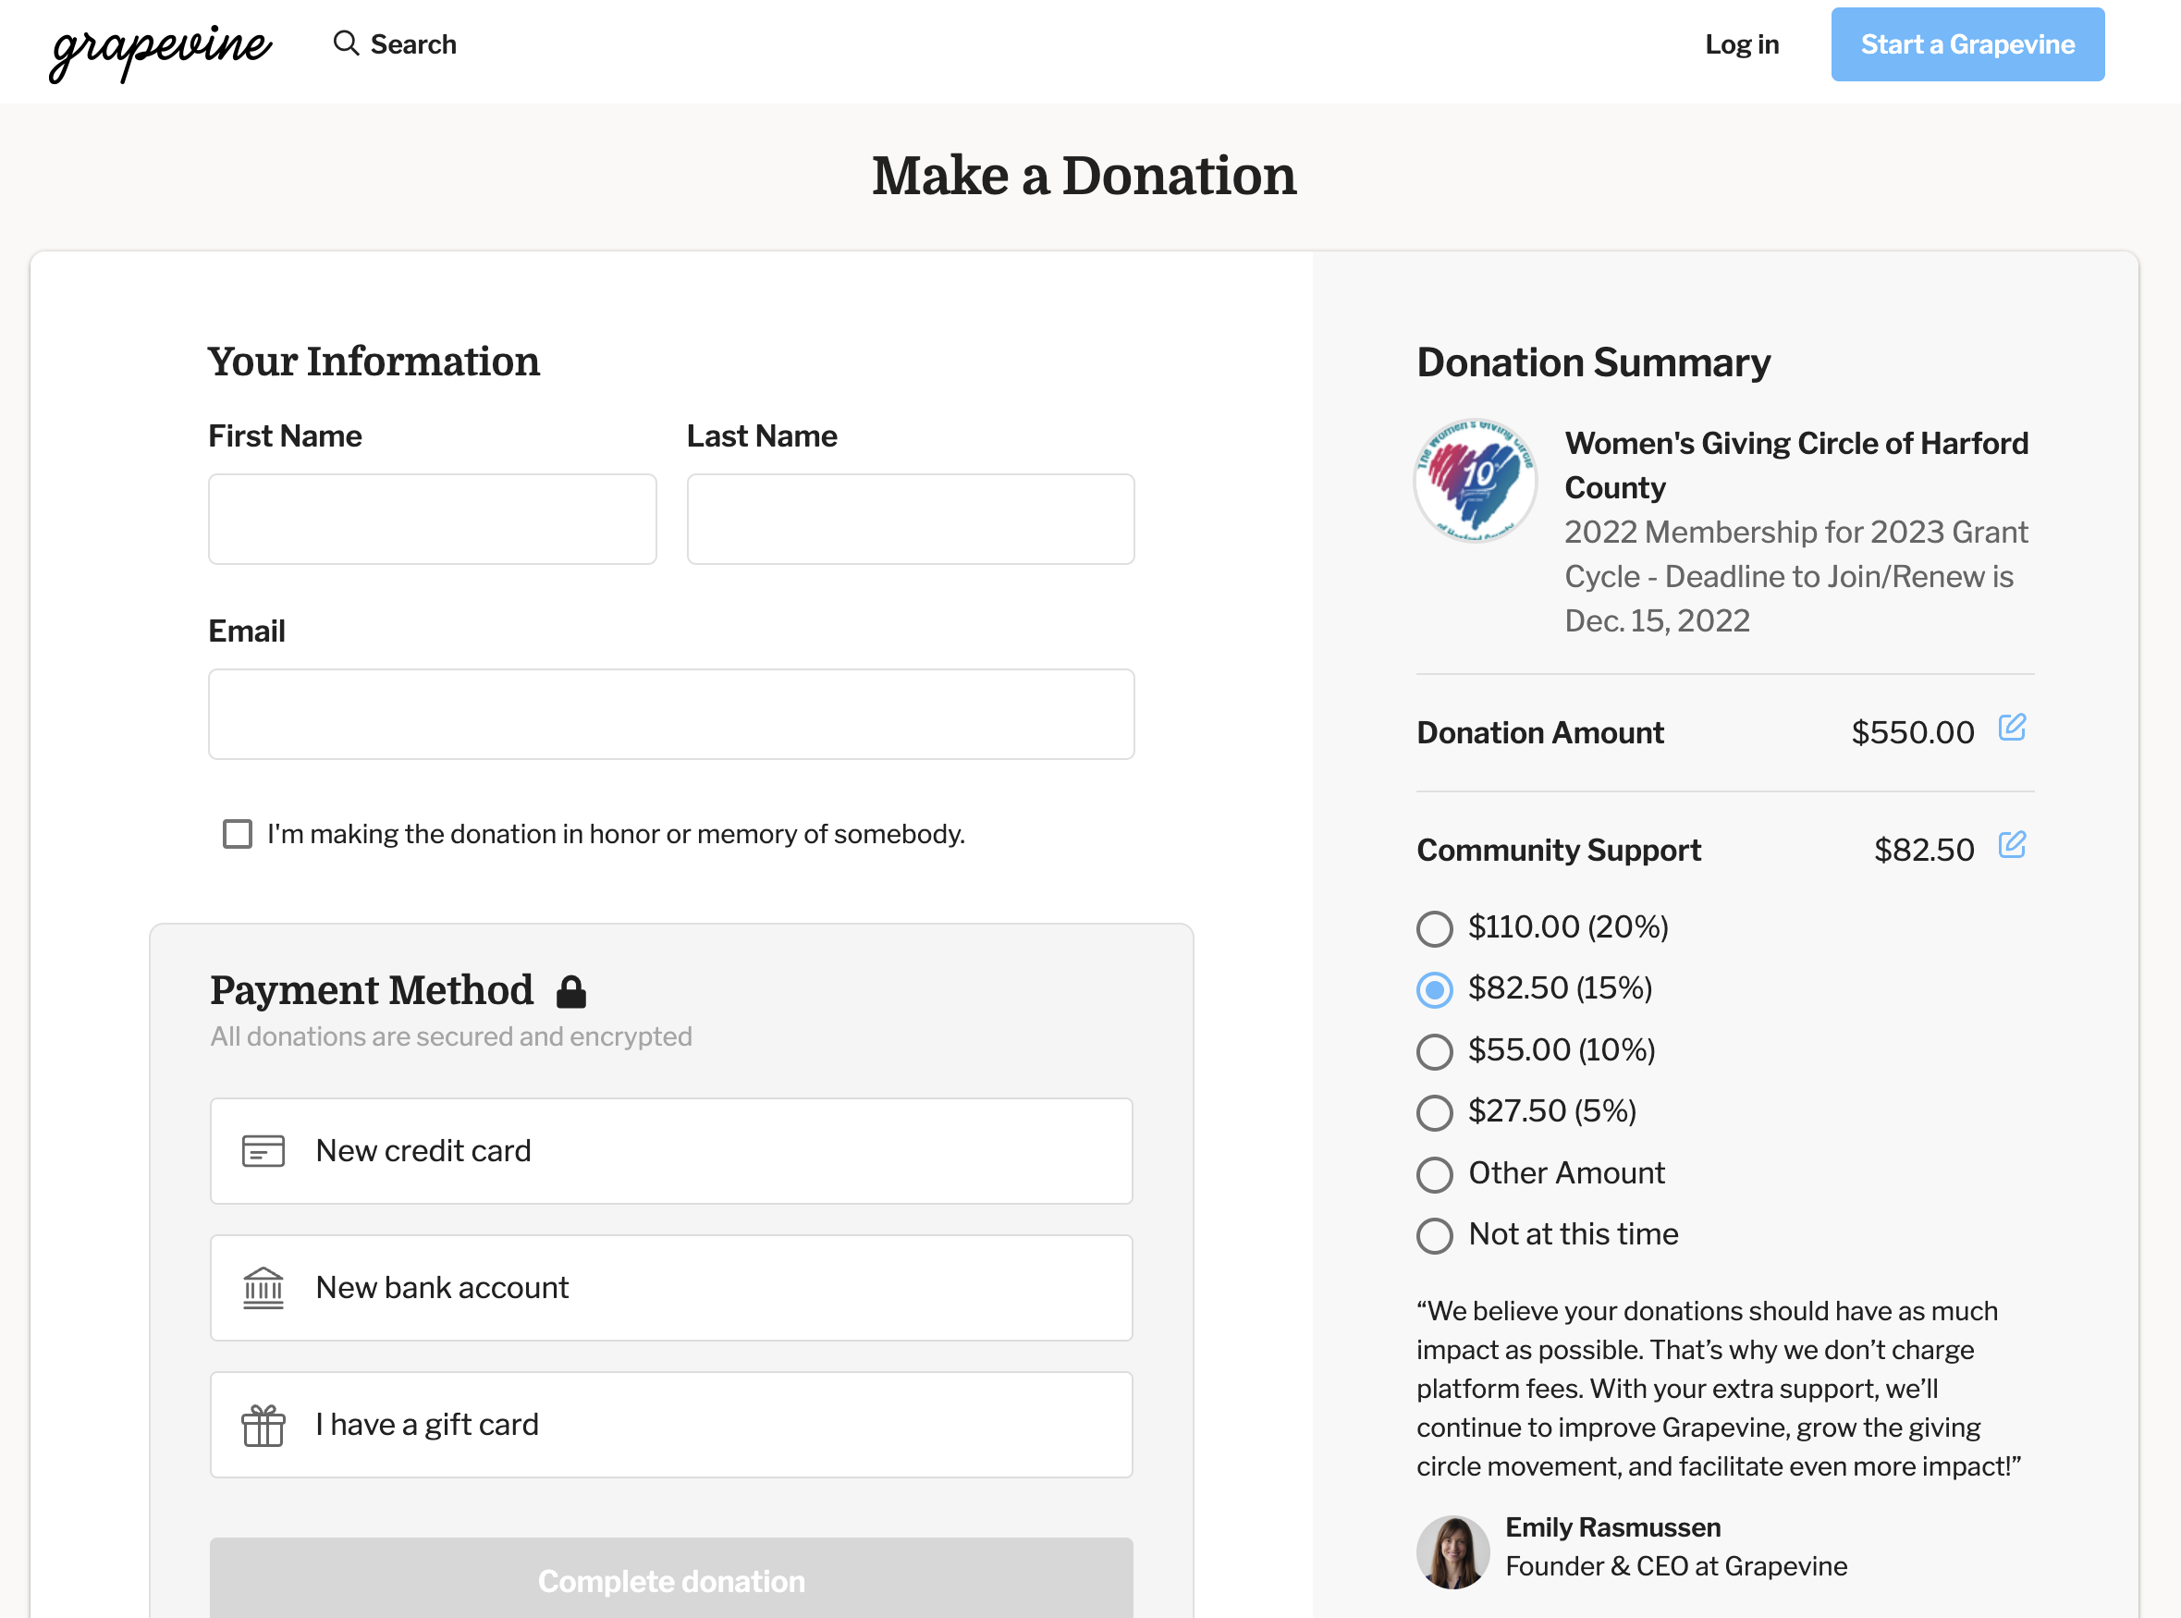
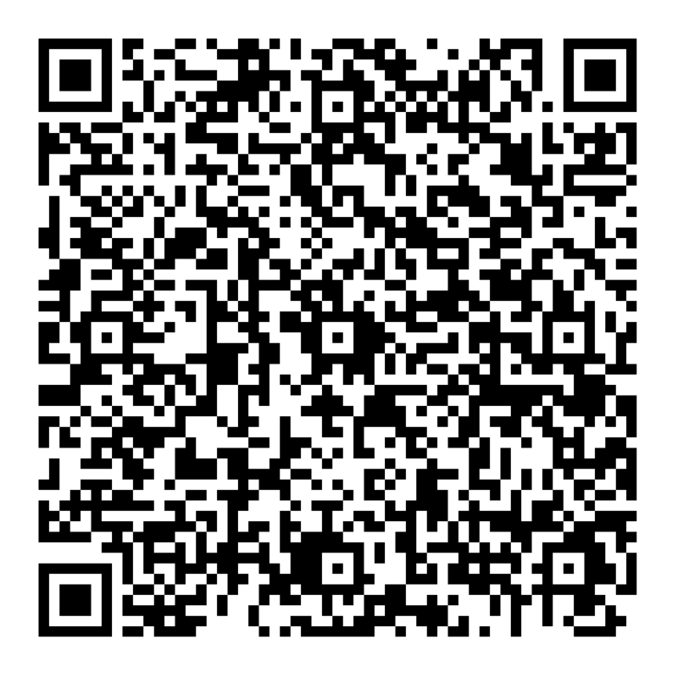
Giving Online
Step 1: Access the Grapevine website.
Step 2: Enter your information and payment method. To revise the Donation and Community Support amount, click on the pencil icon.
Notes:
D2

Slide 33
Closing Remarks
Bonnie Miranda
Notes:
Donna introduce Bonnie

Slide 34
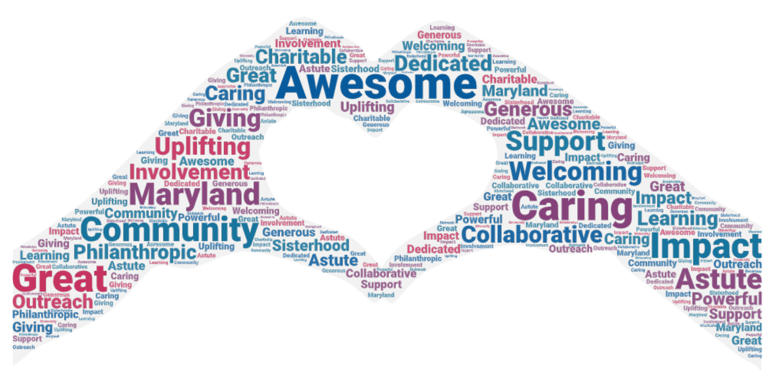
Notes:
Donna introduce Bonnie

Slide 35
Thank you!

