Slide 1
Grantee
Showcase
September 19, 2023
Notes:
Donna

Slide 2
2023-2025 Executive Board
    Donna Kreis
    Chair
    Vacant
    Vice Chair
    Bonnie Miranda
    Secretary
    Kelley Pugh
    Treasurer
    Kim Malat
    Past Chair
    Hillary Smolenski
    Grant Committee Chair
    Donna Kahoe
    Membership & Outreach Committee Chair
    Debbie Lynch
    Communications Chair
    Terri Garland
    Members’ Choice Award Committee Chair
Notes:
Donna

Slide 3


Circle Update – Grants to Date
                13 Years
                $ 564,924.14
                162 Grants
                60 Nonprofits serving women, families, and children in Harford County
Notes:
D1

Slide 4
Finance Report
Kelley Pugh
Notes:
Donna to Introduce Kelley

Slide 5

Fund Balances
                $141,695.30 Endowed Fund (as of 8/21/2023)
                $5,991.61 for 4th Members’ Choice Award
                $36,011.87 Grant Fund for 2023 (as of 9/10/2023)
                $3,028.13 Administrative Fund (as of 9/6/2023)
Notes:
Kelley
Endowed Fund – Up $2,696 from last December
Grant Fund – Last year, our grant fund had $15,486 by 9/12/2022 → This year, we have $36,011 (Early member renewals & New members + Return of Sleep in Heavenly Peace $5,000 grant)

Slide 6

Membership and Outreach Committee Report
“Alone, we can do so little. Together, we can do so much.”
-Helen Keller
Notes:
Kelley introduce D2

Slide 7

Membership
On 1/1/23, we had 109 active members
As of 9/11/23, we have 134 active members
  3 Next Generation members
2023 Goals????
  Reach 140 active members by 12/15/2023
  Welcome 31 new members
Notes:
D2
Stress importance of membership – members = grants

Slide 8
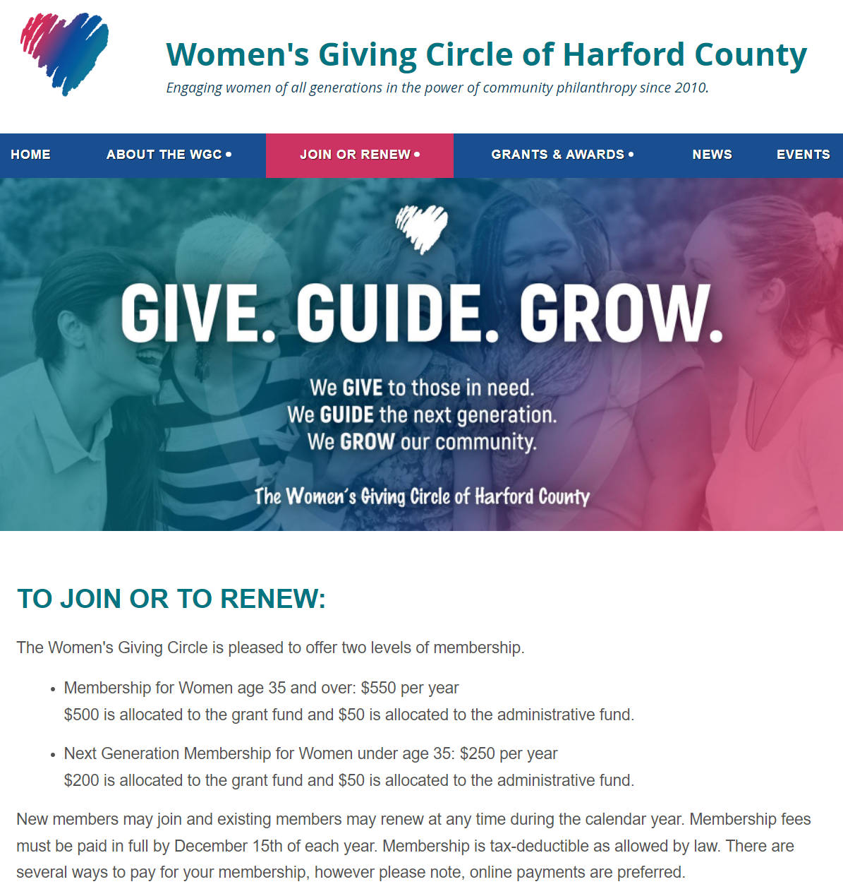
Membership Renewal
Four ways to renew:
  Credit Card or Bank Account
  Check
  Donor Advised Fund
  Direct Transfer / ACH Payment
Notes:
D2
If you just joined this year or have already paid in 2023, ignore this. If you haven’t renewed, there are four payment methods.

Slide 9
Upcoming Events
Save the Date
"Lunch & Learn” Event at Chesapeake Therapeutic Riding
  October 6, 1-3 pm
  WGC members and guests are welcome to meet this grantee's team & learn of their amazing program!
Holiday Happy Hour & Giving Tuesday Event
  November 28, 5-7:30 pm at Maryland Golf and Country Clubs
  Announcement of the 2023 Members’ Choice Award!
  Member mix and mingle
Notes:
D2

Slide 10
2023 Grantees
Hillary Smolenski
Notes:
D2 to introduce Hillary

Slide 11
2023 Grant Awards
$54,724 to 13 Deserving Applicants (*new recipient)
$3,849 $5,000 $5,000 $5,000 $5,000 $2,000 $5,000 $5,000 $1,375 $5,000 $4,500 $5,000 $3,000 | Chesapeake Therapeutic Riding, Inc. CASA of Harford County Girls on the Run of Central Maryland, Inc. Homecoming Project, Inc. Boys and Girls Club of Harford and Cecil Counties The Forgotten Initiative-Harford* The Sexual Assault/Spousal Abuse Resource Center The Sharing Table Harford County Family Assistance Fund Improving Education LASOS, Inc. Coming of Kings, Inc.* The HOPE Center of Maryland, Inc.
Notes:
Hillary

Slide 12
Chesapeake Therapeutic Riding
Breathe Better at CTR
$3,849
The grant will cover the cost of (1) Micro Rain M25 water wheel. This device will reduce the amount of dust in the air, making riders and volunteers more comfortable.
Notes:
Hillary

Slide 13
CASA of Harford County
Tutoring Services
$5,000
This grant will provide tutoring services for children currently being served by CASA of Harford County.
Notes:
Hillary

Slide 14
The HOPE Center of Maryland, Inc
Beyond Blessings
$3,000
This grant will provide 75 low-income students with a backpack filled with shelf-stable meals to ensure students do not go hungry over weekends and during the holidays.
Notes:
Hillary

Slide 15
Girls on the Run of Central Maryland
Harford County Program Expansion Initiative
$5,000
GOTR will utilize grant funds to grow participation among Title 1 schools in Harford County. Additionally, they will purchase running shoes for any participant in need.
Notes:
Hillary

Slide 16
Homecoming Project
Life Skills Group
$5,000
This grant will cover the cost of a 20-week life skills group. Each group will include 8 participants and 1-2 licensed counselors.
Notes:
Hillary

Slide 17
Boys and Girls Club of Harford and Cecil Counties
Summer Camp
$5,000
Grant funds will be used to run a summer camp that is designed to promote and sustain learning in youth of all ages during the summer months.
Notes:
Hillary

Slide 18
The Forgotten Initiative -Harford
Life Skills 101
$2,000
This grant will be utilized for a weekly life skills class for transitional children (ages 14-21) in foster care. The classes will teach cooking, preparing a resume, finding affordable homes, financial literacy, and will help to identify career goals.
Notes:
Hillary

Slide 19
The Sexual Assault/Spouse Abuse Resource Center
Phelan Safehouse Client Needs
$5,000
This funding will allow SARC to purchase new car seats, strollers, and bedding and will provide childcare and ride share assistance.
Notes:
Hillary

Slide 20
The Sharing Table
Weekly Meal and Grocery Distribution
$5,000
This funding will provide meals and groceries to those in need in the Edgewood community.
Notes:
Hillary

Slide 21
Harford County Family Assistance Fund
$1,375
This program will provide 25 children who are entering into out-of-home care with luggage in order to help their transition go as smoothly as possible and to ensure that their special items come with them.
Notes:
Hillary

Slide 22
Improving Education
Bedtime in a Box
$5,000
This program will provide low-income families with books and healthcare materials to establish a nightly routine that supports their child’s health, sleep and early learning. Each box will have 4 age-appropriate books, bath wash, a towel, bath toys, toothbrush, toothpaste, pajamas, a stuffed animal, alarm clock, learning kit, and a kid-friendly routine log.
Notes:
Hillary

Slide 23
LASOS, Inc
Summer Program “On the Town Fridays”
$4,500
This funding will cover the cost to rent the Bel Air Armory on Fridays. This will allow LASOS to run their camp 5 days per week over the summer. Those being served by the camp are children aged 4-21 who are enrolled in school in Harford County who do not speak English as their first language.
Notes:
Hillary

Slide 24
Coming of Kings
Mentoring Program
$5,000
This grant will allow boys to meet with mentors each Sunday from 1-3 p.m. The program will include speakers and field trips with a focus on leadership development, college preparation, and work readiness.
Notes:
Hillary

Slide 25
Members’ Choice Award Update
Terri Garland
Notes:
Hillary introduce Terri

Slide 26
Members’ Choice Award
                Established in 2020
                Distribution from Endowed Fund held by the Community Foundation
                2022 Recipient:
                The Brandon Tolson Foundation
  $5,517.28
  Nominated by Debbie Lynch
  Planning underway for 4th award
  2023 Distribution = $5,991.61
Notes:
Terri

Slide 27
Closing Remarks
Bonnie Miranda
Notes:
Donna introduce Bonnie

Slide 28

Notes:
Donna introduce Bonnie

Slide 29
Thank you!

