Slide 1
Organizational Guidelines Vote Meeting
February 6, 2024
Notes:
Donna

Slide 2
Proposed Membership Levels
                Add two new membership levels
                Members under 30 years
                Members over 70 years
                Add names for each membership level
                Extend age limit for Next Generation membership to 40 years
Membership Level | Age (at Time of Payment) | Annual Membership Donation
Inspire | Under 30 years | $150
Connect | 30-40 years | $250
Empower | 41-70 years | $550
Sustain | Over 70 years | $250
Notes:
Advantages:
- Inspire membership level is meant to attract women at the younger age spectrum (to introduce them to philanthropy) at a level they can afford
- Sustain membership level is meant to retain those members who may have left the workforce and are on a fixed income
- Names allow for our membership committee to better market the various membership levels
- Extended Next Gen (now called Connect) enables those members who are still early in career and establishing families to remain at a more affordable level

Slide 3
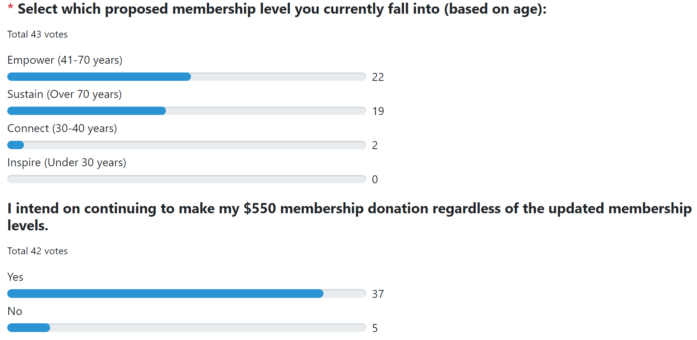
Impact of Changes:
Survey Results
                43 responses for 128 members
Four “No” responses for members over 70
One “No” response for member in the Connect age range

Slide 4
Additional Organizational Guideline Proposed Edits
                Revised membership renewal deadline from December 15 to December 1
                Minor edits for consistency and clarity
                Revised fiscal sponsor reference for grant and admin funds
                Added Tami Zavislan as an Honorary Founding Member
                Added responsibilities for the Communications Committee and Members’ Choice Award Committee
                Further defined the Executive Board membership
Notes:
Deadline change allows us to wrap up our membership drive at the very beginning of January.

Slide 5
Additional Organizational Guideline Proposed Edits
                Combined the Community Outreach and Engagement Committee with the Membership Committee responsibilities under the Membership and Outreach Committee
                Further defined the responsibilities of the Chair, Secretary, and Treasurer
                Simplified the Staff section to eliminate outdated language

Slide 6

Notes:
Donna

Slide 7
Thank you!

